Slide 1
NetSI: networks research @ SI
Lada Adamic, Jiang Yang, Eytan Bakshy, Xiao Wei, Matthew Simmons, Edwin Teng, David Huffaker

Slide 2
What we study
How networks shape information diffusion
How information diffusion shapes networks
Where you can find us:
http://netsi.org

Slide 3
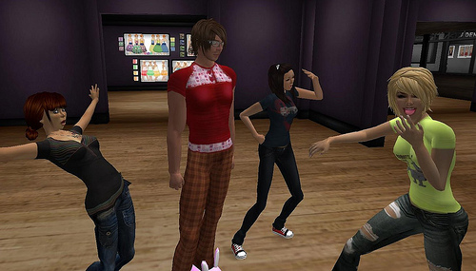
Social dynamics of information in virtual spaces (e.g. Second Life)
Items diffusing through social network spread more rapidly but have limited range
Sellers who chat up customers enjoy more repeat business, but social interaction doesn’t scale
POSTER
Eytan, Matt, Edwin, Dave, & Lada, EC’09, ICWSM’10

Slide 4
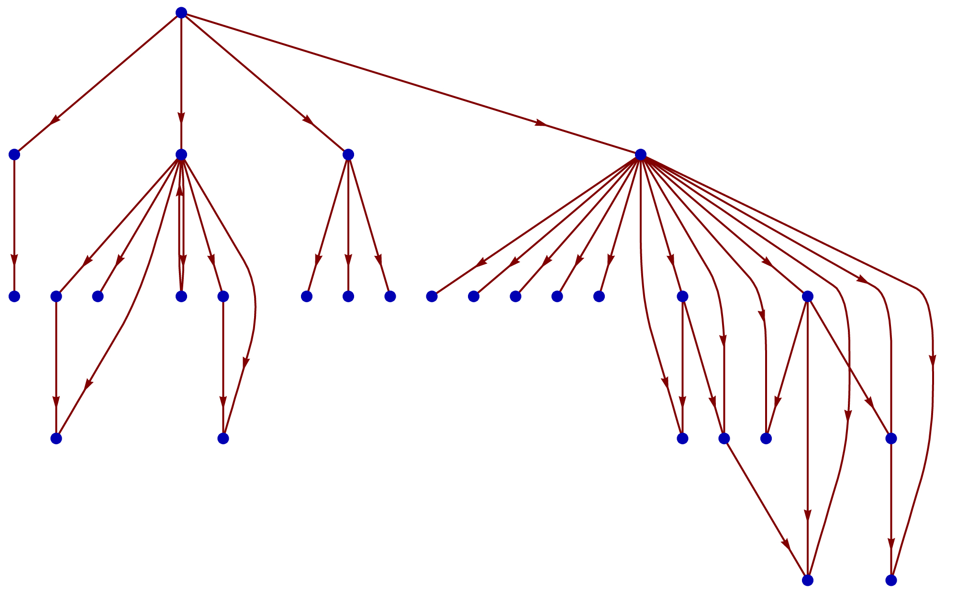
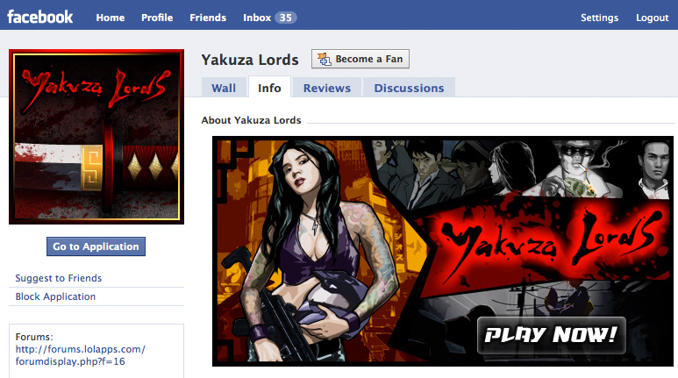
Viral diffusion of social games on Facebook
Invitation behavior…
batch vs. individual invites
inviting many vs. few friends
… is more predictive than
demographics
social network structure
Being invited
means increased likelihood of staying longer
Games that favor groups
gobble up dense cliques
POSTER
Xiao, Jiang, and Lada collaborating with Ricardo Matsumura de Araújo and Manu Rekhi

Slide 5
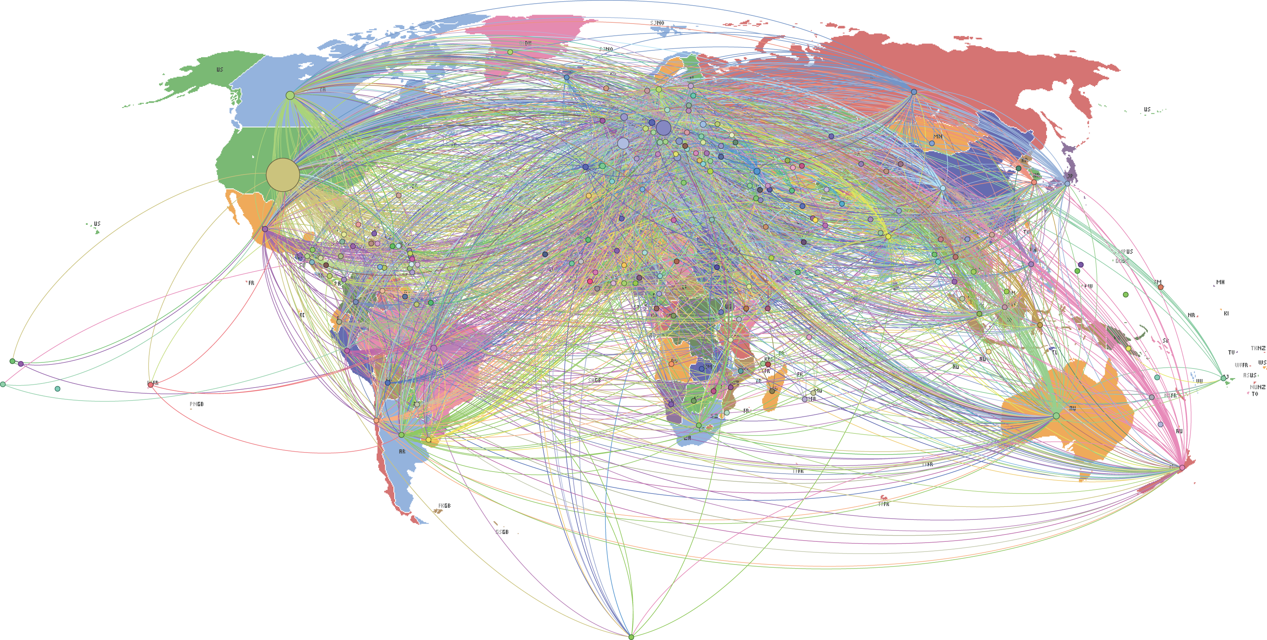
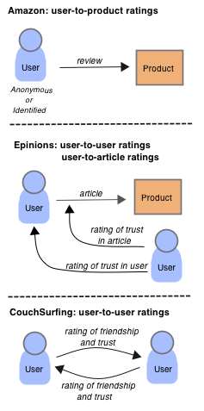
Networks of trust: I rate you. You rate me. Should we do so publicly?
POSTER
trust: private ratings, low correlation
friendship: public ratings, high correlation
Edwin & Lada collaborating with Debra Lauterbach

Slide 6
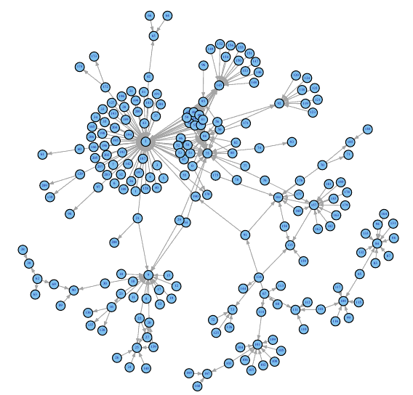
Tracing memes across the web
How do memes change as they diffuse
length
sentiment
content
How does their diffusion/evolution depend on the underlying network structure?
length of phrase
POSTER
duration in days
Matt & Lada collaborating with Eytan Adar

Slide 7
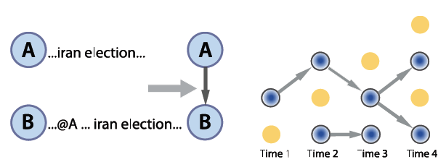
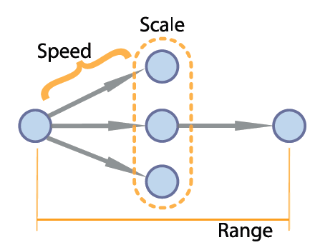
Predicting the Speed, Scale, and Range of Information Diffusion in Twitter
Trace social diffusion through @username mentions
Properties of users (e.g. past popularity) more predictive than properties of tweets when it comes to speed, scale & range of diffusion
POSTER
Jiang collaborating with Scott Counts, ICWSM 2010

Slide 8
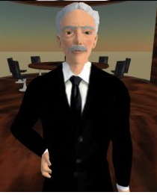
Longevity in Second Life
POSTER
How can you predict who will stay and who will leave?
those who stay are chatting ☺
social network tie
direct chat
monetary transaction
Edwin & Lada, ICWSM’10 poster

Slide 9
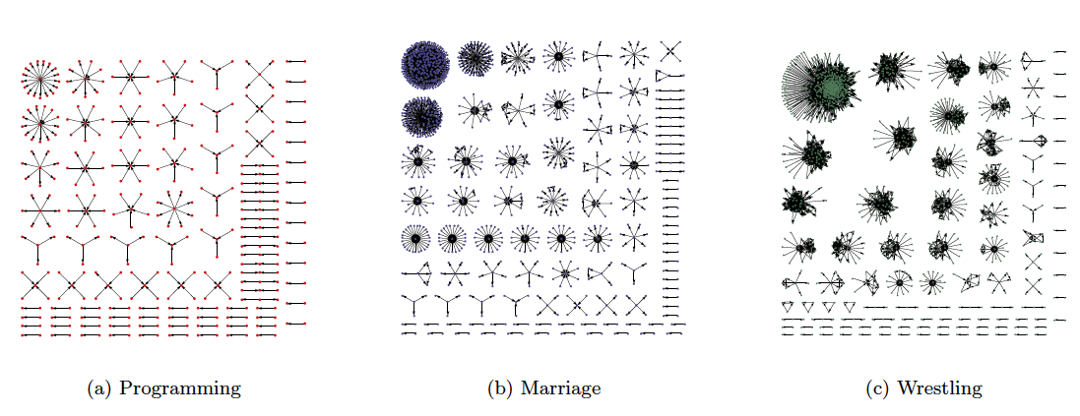
Mapping interactions identifies Q&A forum types & experts
Lada & Eytan collaborating with Jun Zhang & Mark Ackerman, WWW2007, WWW 2008

Slide 10
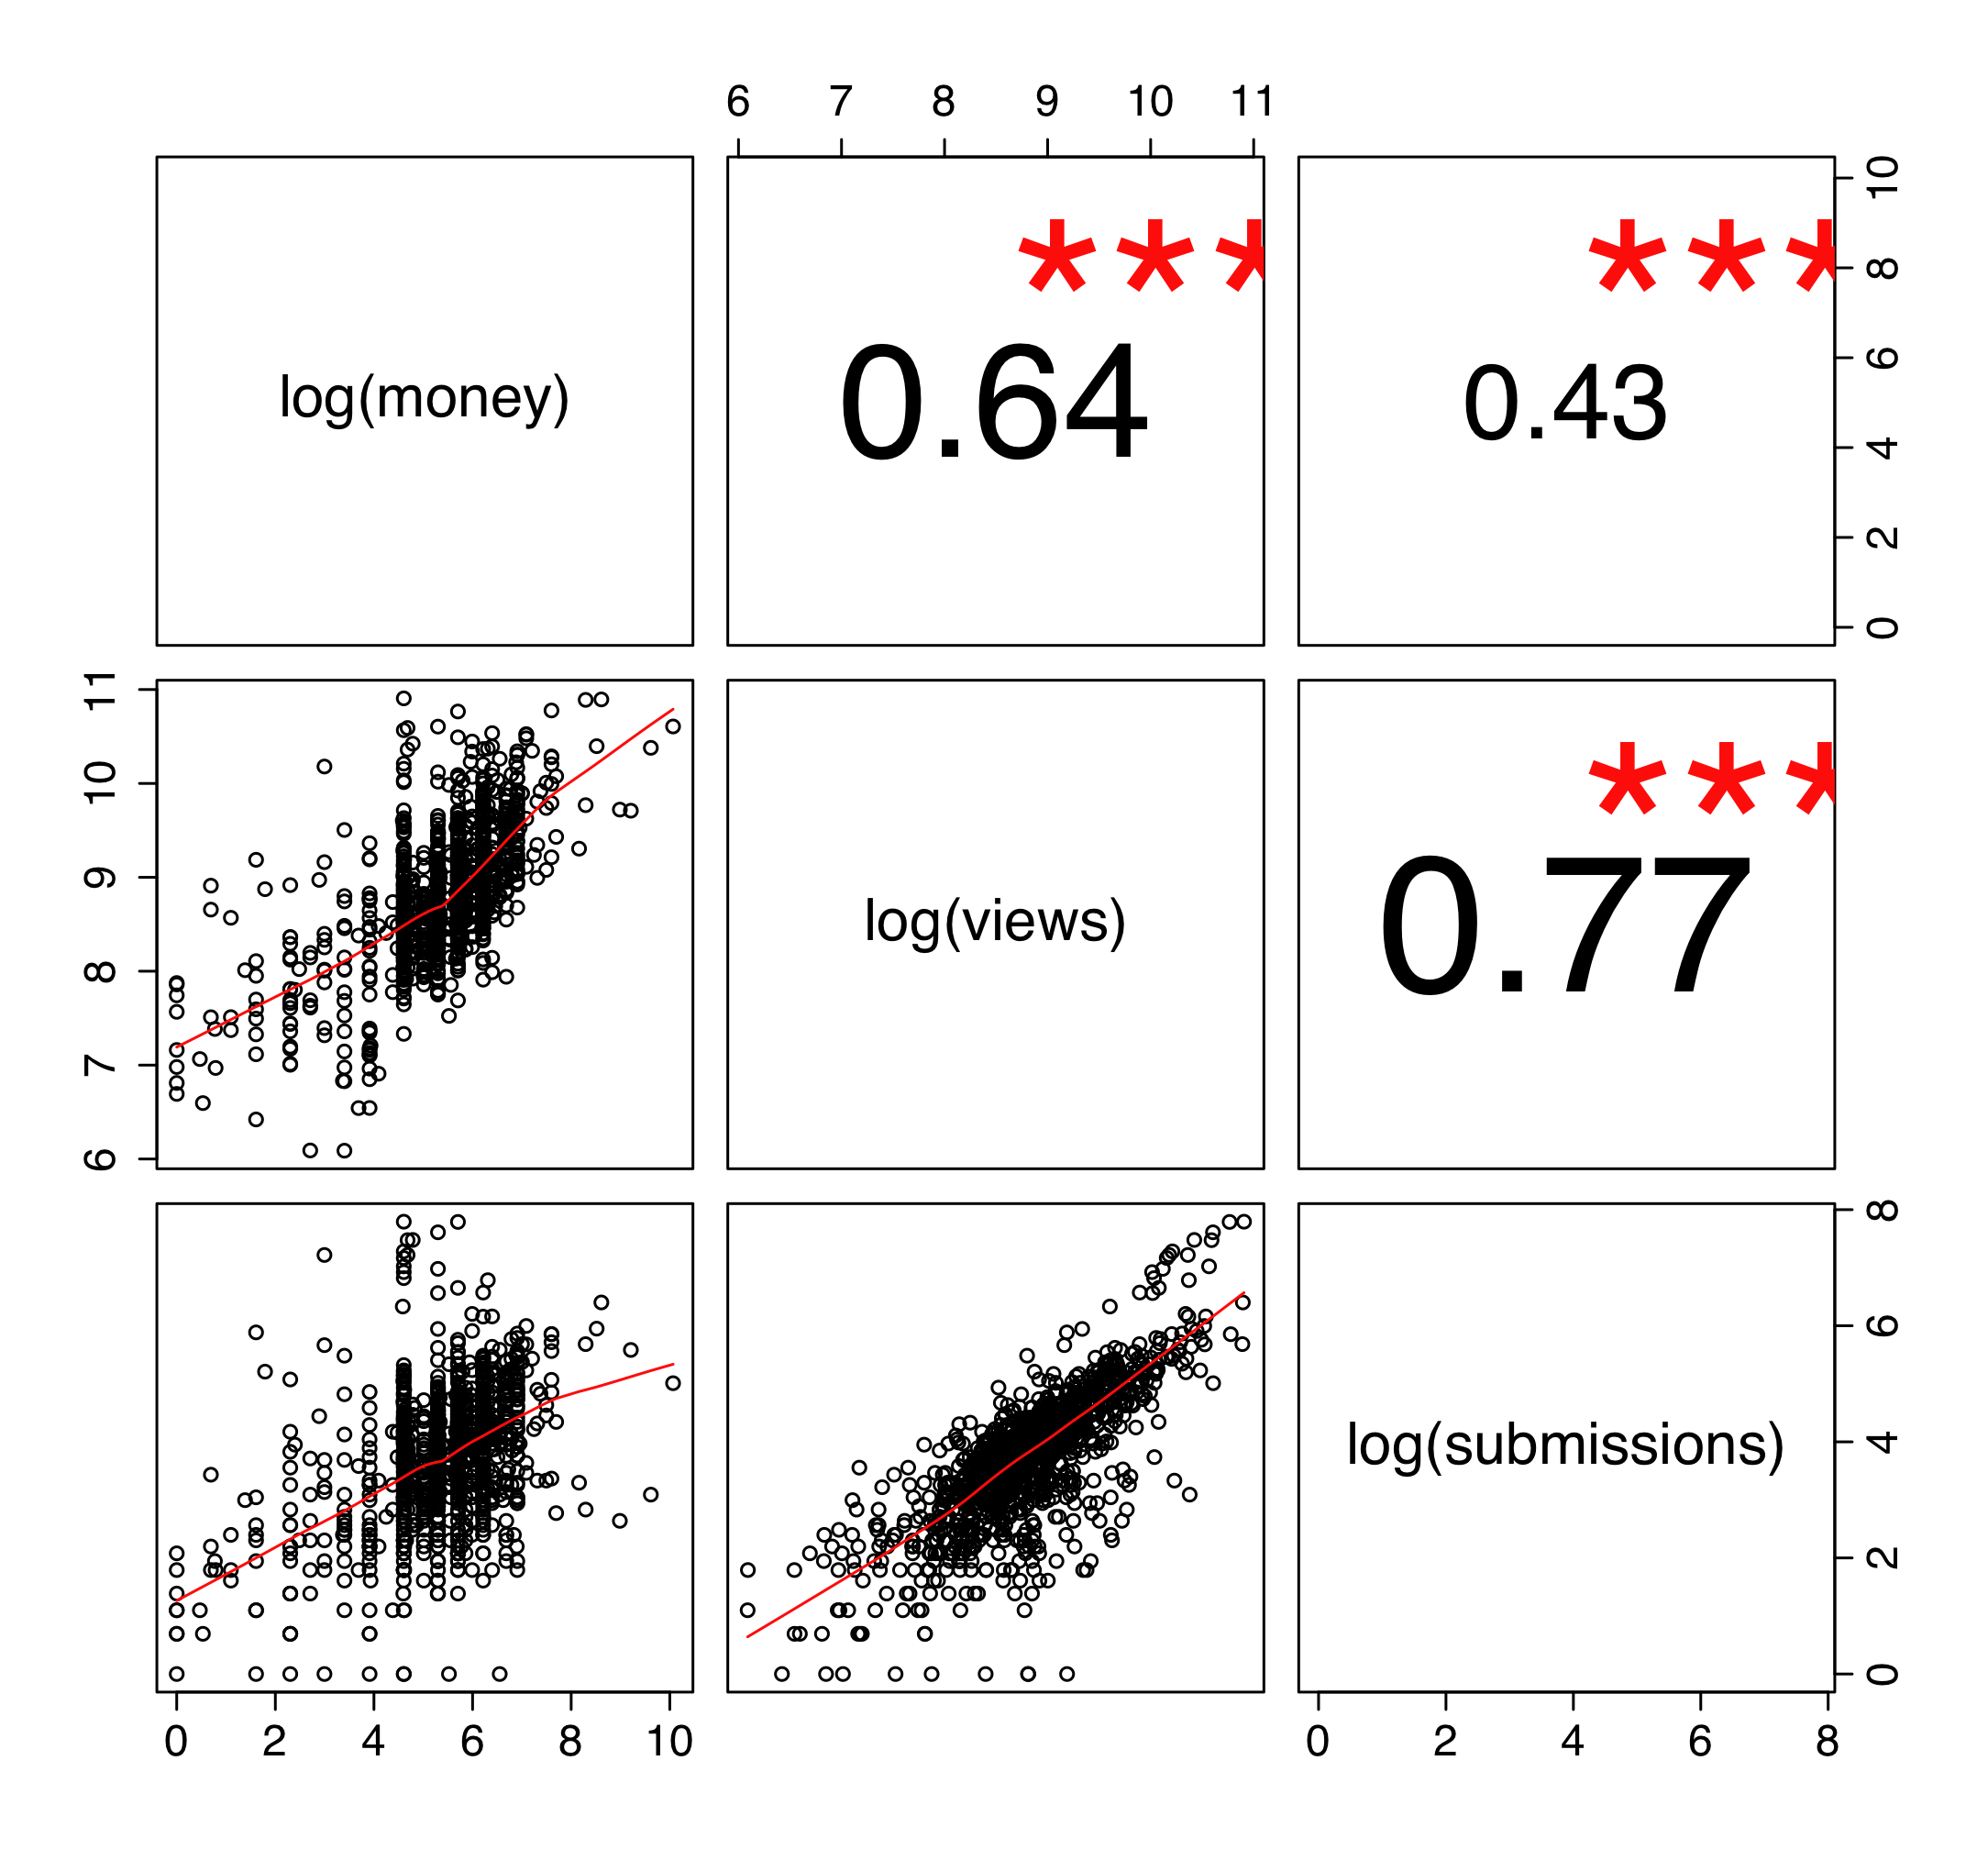
How virtual points & real bucks influence participation in Q&A forums
Jiang, Xiao & Lada collaborating with Mark Ackerman, Tracy Liu, Yan Chen,
ICWSM’08, EC’08, ICWSM’09, ICWSM’10

Slide 11
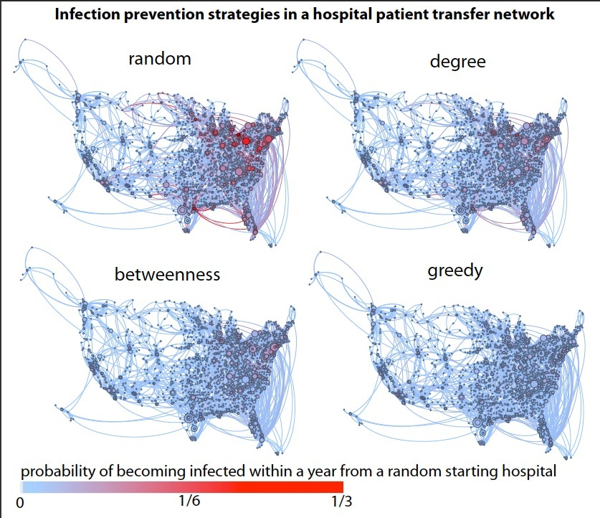
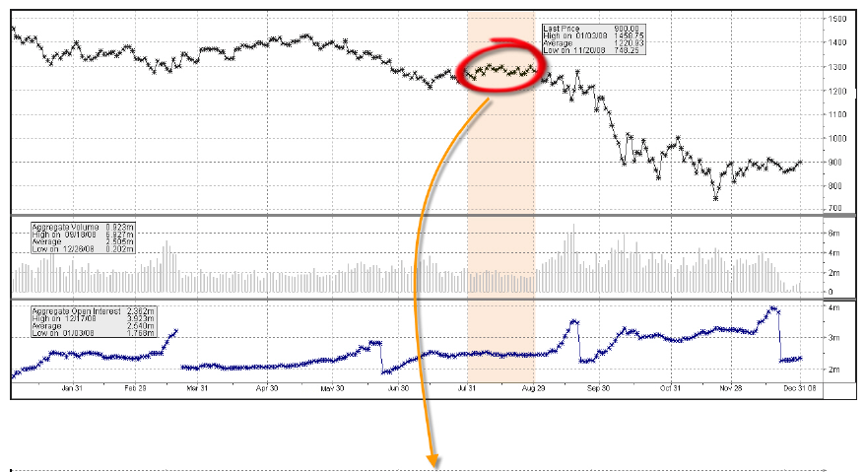
Different kinds of networks: highly resistant bacteria hopping from hospital to hospital financial trading networks

Slide 12
http://netsi.org
Come meet us at the session
POSTER

