Slide 1
ChemReader
Workshop on Data, Text, Web, and Social Network Mining
Apr. 23, 2010, University of Michigan, Ann Arbor
Tunable Machine Vision-Based Strategy for Automated Annotation of Chemical Database
Jungkap Park, Gus R. Rosania, and Kazuhiro Saitou
University of Michigan, Ann Arbor

Slide 2
Why ChemReader?
Chemical Database
Corpus of scientific literature
PubChem
ChemBank
ChemDB
ChemMine
DrugBank
GLIDA
QueryChem
Journals
Patents
Books
Papers
Project reports
Websites
Theses
ChemReader
…
…

Slide 3
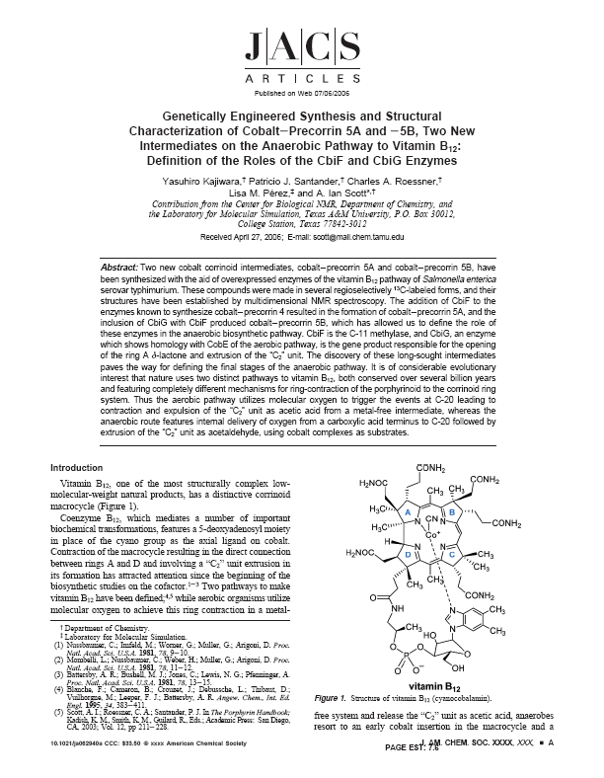
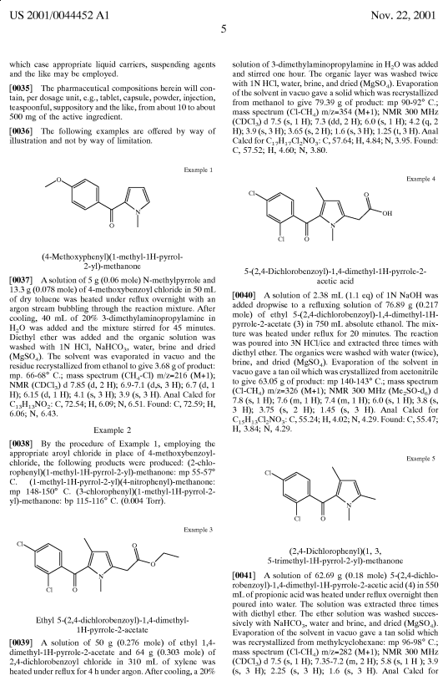
Chemical information
Chemical structure in scientific literature
Generic name, systematic nomenclature, index number
2D chemical structure diagram

Slide 4
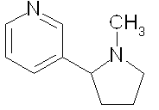
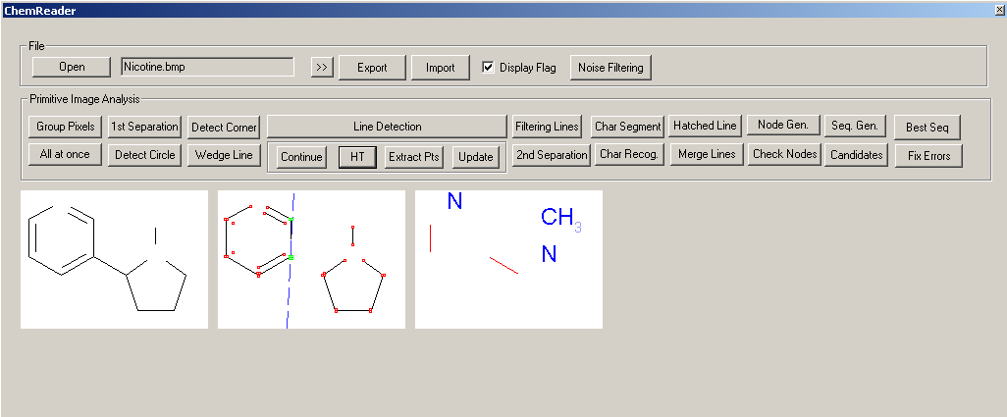
General Chemical OCR Strategy
Chemical OCR
Extract 2D chemical structure diagram from literature
Convert them to a standard chemical file format
CN1CCCC1C2=CN=CC=C2
Input
: Image of chemical structure diagram
Chemical OCR
: ChemReader
Output
: SMILE String

Slide 5
Image based annotation
Searching for chemical information
Many synonyms
Need to identify related compounds
Many chemical structures in journals referenced by chemical structure diagrams
Chemical database annotation using Chemical OCR

Slide 6
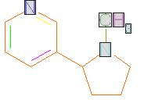
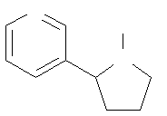
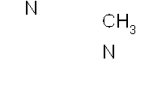
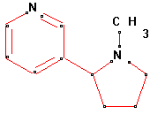
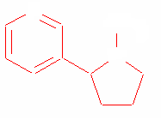
General chemical OCR process
General recognition process
Original digital image
Connected components
Character Separation
CN1CCCC1C2=CN=CC=C2
Standard chemical file format
Graph compile
Bond detection
Character Recognition

Slide 7
Novel features of ChemReader
Robust line & ring structure detection algorithm based on Hough Transformation
Chemical dictionary and chemical spell checking
Pre-processing and post-processing filters to discard non-annotatable images
Original Image
Analyzing Image
Result
Park, J.; Rosania, G. R.; Shedden, K. A.; Nguyen, M.; Lyu, N.; Saitou, K. Automated Extraction of Chemical Strucuture Information from Digital Raster Images. Chem. Cent J. 2009, 3, Article 4

Slide 8
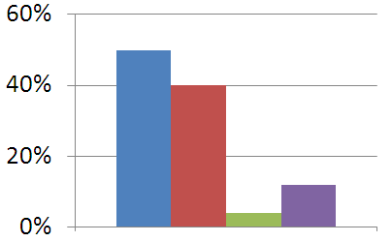
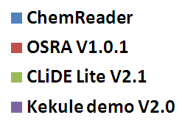
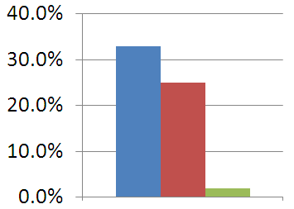
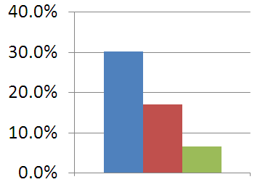
Recognition Performance
The fraction of correct outputs
Google Image Search
GLIDA images
Journal images

Slide 9
Annotation strategy
Automated annotation by linking published journal articles to entries in a chemical database
ChemReader to extract chemical structure diagram
Chemical expert system for screening the converted structures
Similarity-based linking to maximize the number of useful links
Park, J.; Rosania, G. R.; Saitou, K. Tunable Machine Vision-Based Strategy for Automated Annotation of Chemical Databases. J. Chem. Inf. Model. 2009, Article ASAP

Slide 10
Annotation Test
Test setting
Total 609 structure diagrams from 121 journal articles
Manual generation of original connection tables
Target database
PubChem database (http://pubchem.ncbi.nlm.nih.gov/)
Two cases of a test
Demonstrate how the Chemical Expert system can be utilized
 | Test I | Test II
Filtering condition | Tolerant level | Strict level
Number of survived structures | 212 | 145

Slide 11
Chemical Expert System Test
Result
Test I
Test II

Slide 12
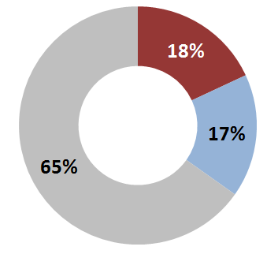
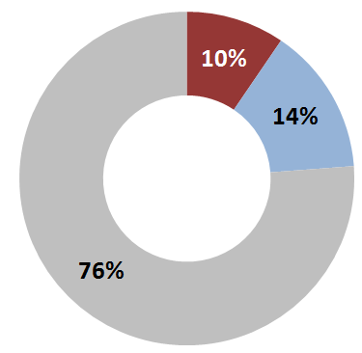
Chemical Expert System Test
Percentages of structures rejected, correct, and wrong
Test I
Test II

Slide 13
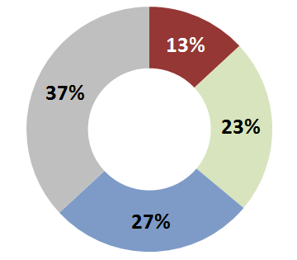
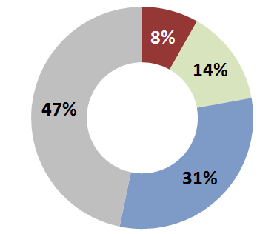
Chemical Expert System Test
Percentages of articles contain rejected, wrong or correct structures
Test I
Test II

Slide 14
PubChem Annotation Test
Filtered output structure
Original connection-table
90% Tanimoto similarity
searching
PubChem Database
(19 million structures)
Linked entries
Relevant entries
 |  | Relevant
 |  | Yes | No
Linked | Yes | True Positive (TP) | False Positive (FP)
 | No | False Negative (FN) | True Negative (TN)

Slide 15
PubChem Annotation Test
Result
Total number of TP, FP and FN links
Averaged recall and precision rates over structures
 | TP | FP | FN
Test I | 29,540 | 34,386 | 28,642
Test II | 23,277 | 6,845 | 7,874
 | Avg. Recall | Avg. Precision
Test I | 0.69 | 0.8
Test II | 0.8 | 0.88

Slide 16
PubChem Annotation Error Analysis
Result
Distribution of recall and precision rates
The size of sphere is proportional to the number of structures corresponding to recall and precision rates.
Test I
Test II

Slide 17
Summary & Conclusion
ChemReader is an developer’s tool for chemical image based annotation of databases
Developed a tunable database annotation strategy based on user-defined relevance of hits
In the annotation test, as many as 45% of articles have true positive links to PubChem entries
Precision and recall rates can be improved with further enhancement of recognition algorithm in ChemReader
Annotation error analysis allows rational prioritization of future development efforts

Slide 18
Thank you!

