Slide 1
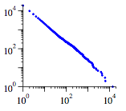
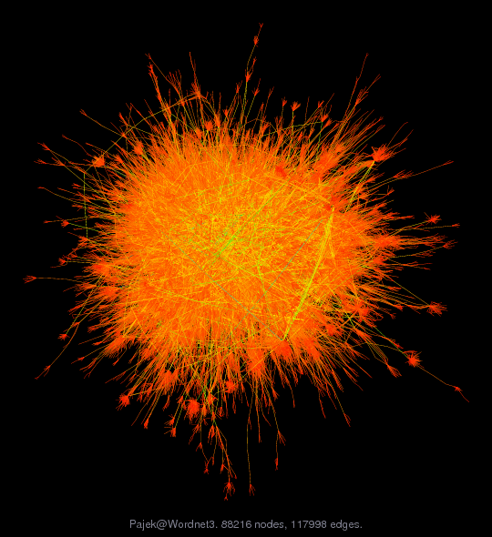
Extracting an Inventory of English Verb Constructions from Language Corpora
Matthew Brook O’Donnell Nick C. Ellis
mbod@umich.edu ncellis@umich.edu
Presentation
University of Michigan Computer Science and Engineering and School of Information
Workshop on Data, Text, Web, and Social Network Mining
23 April, 2010
Notes:
1

Slide 2
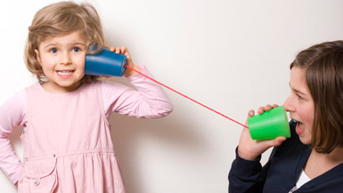
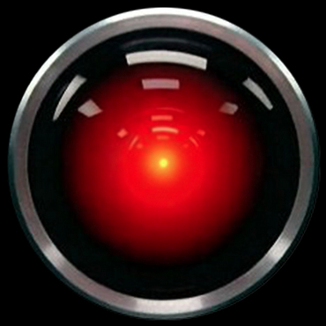
Learning meaning in language Constructions in language acquisition
How are we able to learn what novel words mean?
The ball mandoozed across the ground
The teacher spugged him the book
V across n
V Obj Obj
each word contributes individual meaning
verb meaning central; yet verbs are highly polysemous
larger configuration of words carries meaning; these we call CONSTRUCTIONS

Slide 3
Learning meaning in language Constructions in language acquisition
How are we able to learn what novel words mean?
We learn CONSTRUCTIONS
formal patterns (V across n) with specific semantics
Associated factors with learning constructions
the specific words (types) that fill the open slots (here the verbs)
the token frequency distribution of these types
type-to-construction contingencies (i.e. the degree of attraction of a type to construction and vice-versa)

Slide 4
Pilot Research Project
Mine 100+ different Verb Argument Constructions (VACs) from large corpus
For each examine resulting distribution in terms of:
Verb Types
Verb Frequency (Zipf)
Contingency
Semantics prototypicality of meaning & radial structure

Slide 5
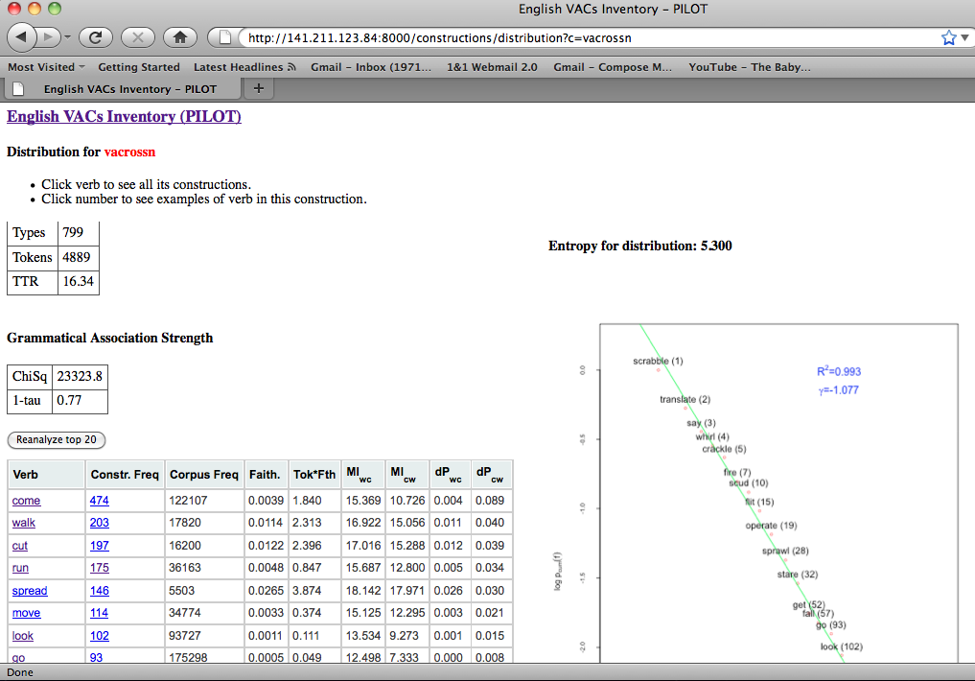
Method & System Components
CORPUS
Word Sense Disambiguation
WordNet
Semantic Dictionary
POS tagging &
Dependency Parsing
BNC 100 mill. words
Statistical analysis of distributions
CouchDB document database
COBUILD Verb Patterns
Web application
Network Analysis & Visualization
Construction Descriptions

Slide 6
Results: V across n distribution
come | 483
walk | 203
cut | 199 | ...
run | 175 | veer | 4
spread | 146 | whirl | 4
... |  | slice | 4
 |  | shine | 4 | ...
 |  | clamber | 4 | discharge | 1
 |  | ... |  | navigate | 1
 |  |  |  | scythe | 1
 |  |  |  | scroll | 1

Slide 7
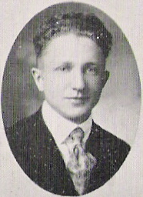
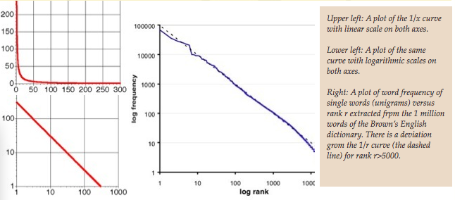
Zipfian Distributions
Zipf’s law: in human language
the frequency of words decreases as a power function of their rank in the frequency
Construction grammar - Determinants of learnability

Slide 8
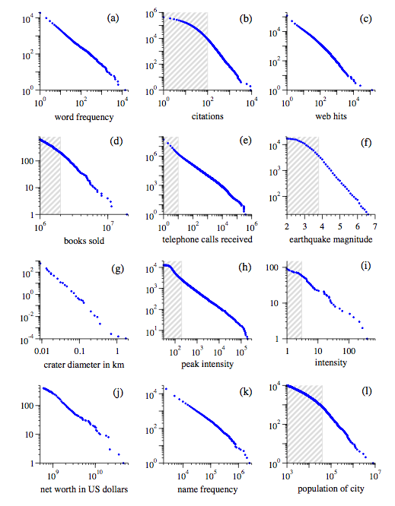
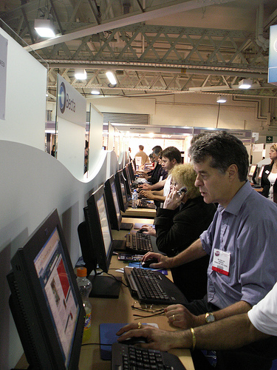
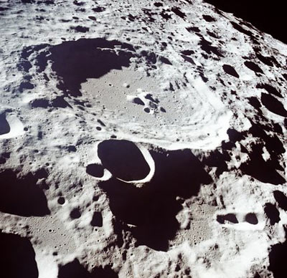
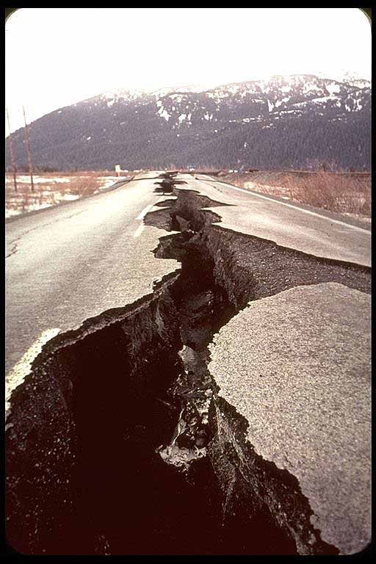
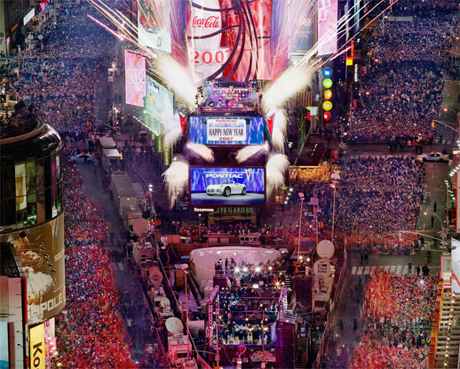
Universals of
Complex Systems

Slide 9
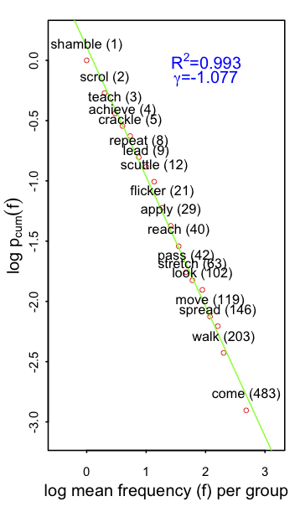
Results: V across n distribution
Tokens | Types | TTR
4395 | 802 | 16.65

Slide 10
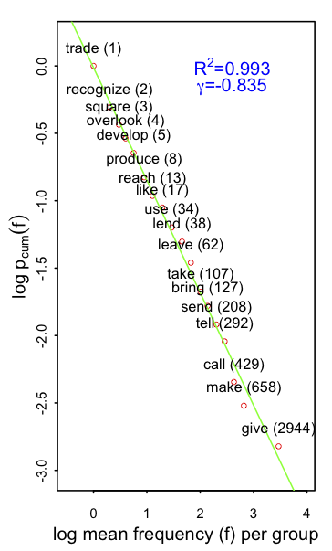
Results: V Obj Obj distribution
Tokens | Types | TTR
9183 | 663 | 7.22

Slide 11
Selecting a set of characteristic verbs
Select top 20 types from the distribution of verbs using four measures:
Random sample of 20 items from the top 200 types
Faithfulness – measures proportion of all of a types occurrences in specific construction
e.g. scud occurs 34 times as a verb in BNC and 10 times in V across n: faithfulness = 10/34= 0.29
Token frequency
Combination of #2 and #3

Slide 12
V across n
 | TYPES (sample) | FAITHFULNESS | TOKENS | TOKENS + FAITH.
1 | scuttle | scud | come | spread
2 | ride | skitter | walk | scud
3 | paddle | sprawl | cut | sprawl
4 | communicate | flit | run | cut
5 | rise | emblazon | spread | walk
6 | stare | slant | move | come
7 | drift | splay | look | stride
8 | stride | scuttle | go | lean
9 | face | skid | lie | flit
10 | dart | waft | lean | stretch
11 | flee | scrawl | stretch | run
12 | skid | stride | fall | scatter
13 | print | sling | get | skitter
14 | shout | sprint | pass | flicker
15 | use | diffuse | reach | slant
16 | stamp | spread | travel | scuttle
17 | look | flicker | fly | stumble
18 | splash | drape | stride | sling
19 | conduct | scurry | scatter | skid
20 | scud | skim | sweep | flash

Slide 13
Measuring semantic similarity
We want to quantify the semantic coherence or ‘clumpiness’ of the verbs extracted in the previous steps
The semantic sources must not be based on distributional language analysis
Use WordNet and Roget’s
Pedersen et al. (2004) WordNet similarity measures
three (path, lch and wup) based on the path length between concepts in WordNet Synsets
three (res, jcn and lin) that incorporate a measure called ‘information content’ related to concept specificity
Kennedy, A. (2009). The Open Roget's Project: Electronic lexical knowledge base.

Slide 14
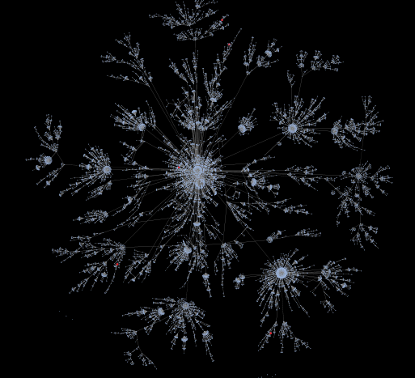
WordNet Network Analysis

Slide 15
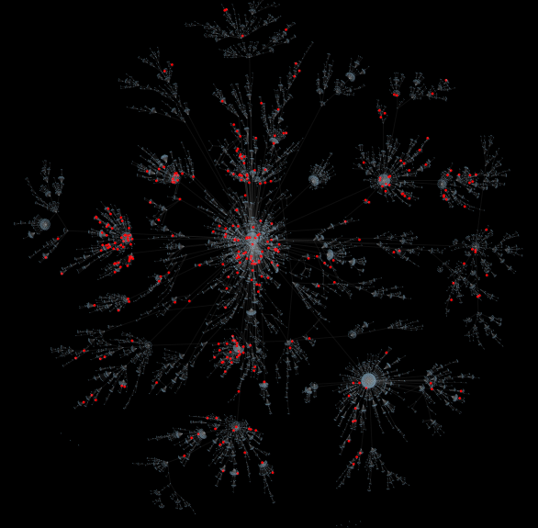

Slide 16
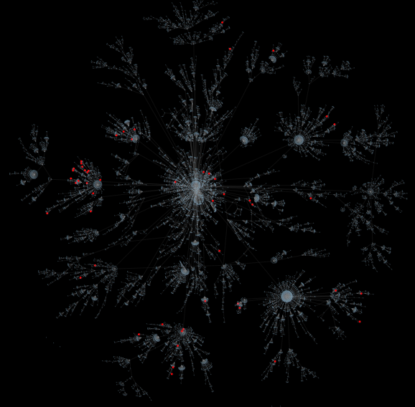
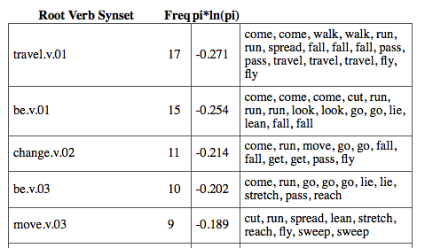

Slide 17
Implications for learning (human & machine!)
Our initial analysis suggest that
moving from a flat list of verb types occupying each construction
to the inclusion of aspects of faithfulness and type-token distributions
results in increasing semantic coherence of the VAC as a whole.
A combination of frequency and contingency gives better candidates for learning/training

Slide 18
Next steps
Exploring better measures of semantic coherence
Make use of word sense disambiguation
Exploring ways of better integrating faithfulness and token frequency
Carry out for all VACs of English
GOAL is to produce:
An open access web-based grammar of English that is informed by linguistic form, psychological meaning, their contingency, and their quantitative patterns of usage.
mbod@umich.edu ncellis@umich.edu

