Slide 1
Temporal-Informatics Research
Eytan Adar
University of Michigan, School of Information and Computer Science & Engineering
April 23, 2010

Slide 2
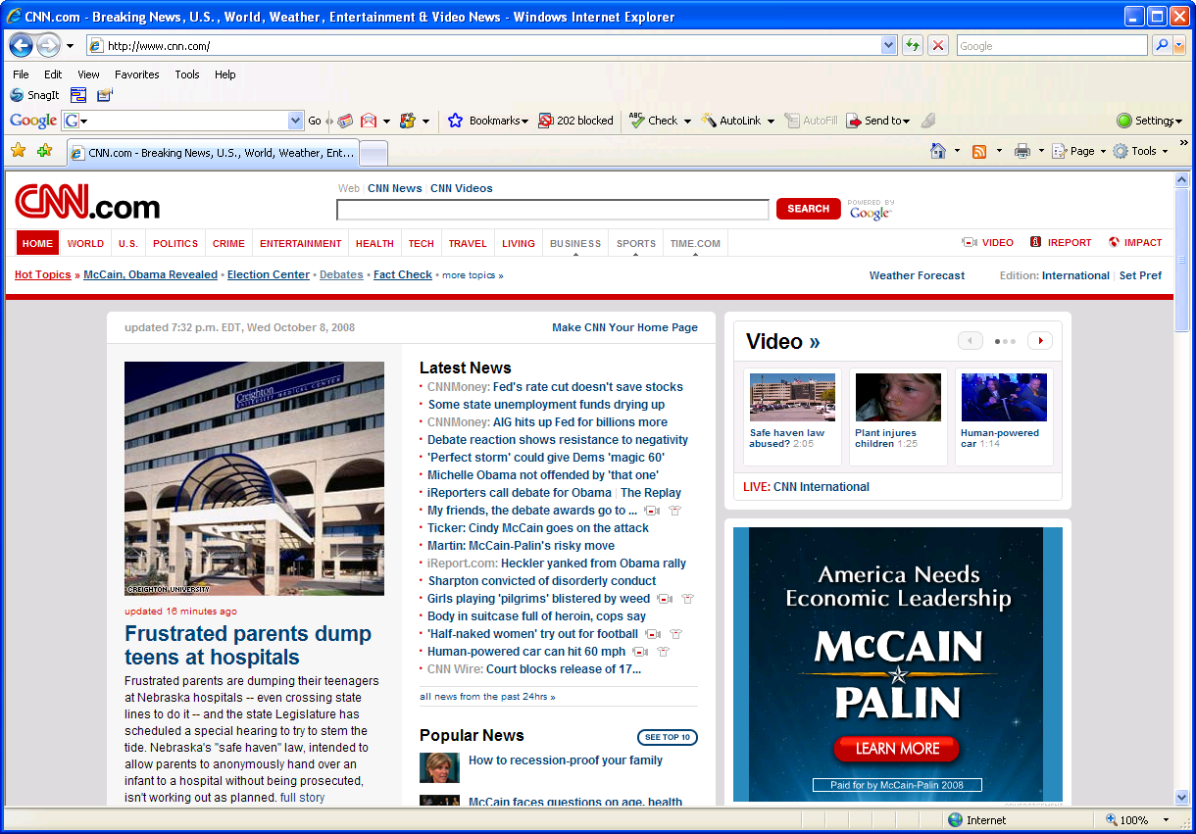
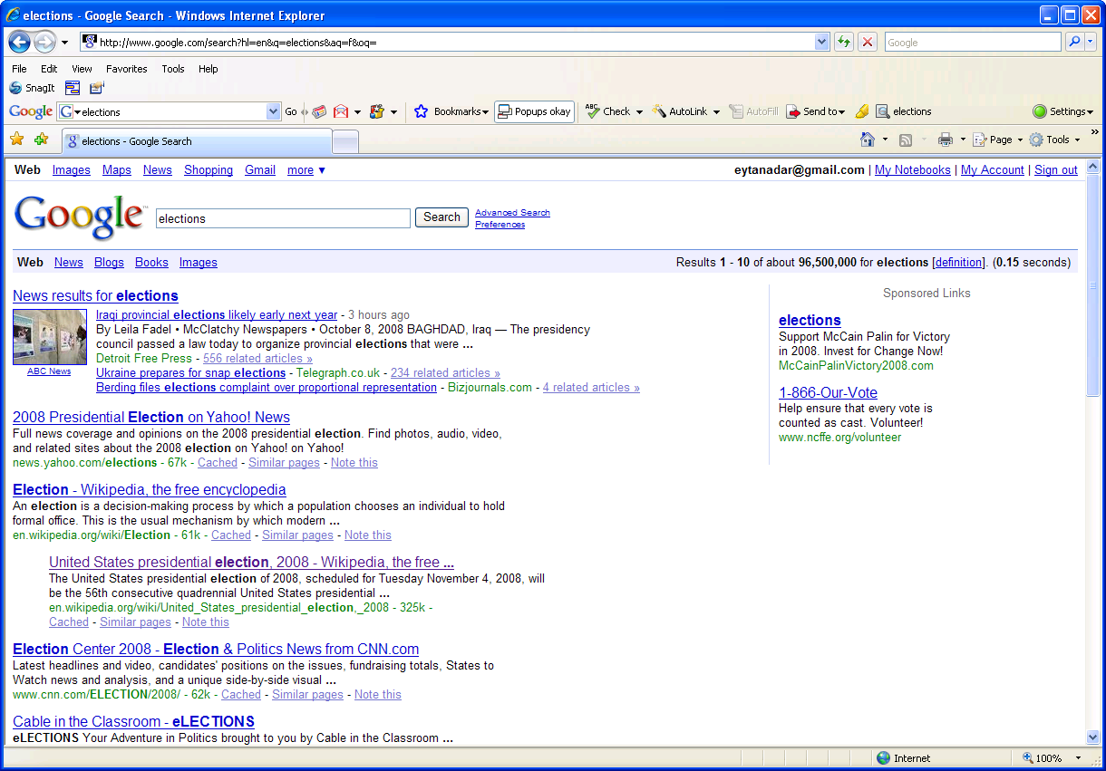
The Now Web
See the web through a browser of “now”
Access services through an index of “now”
Temporally insensitive
(ignore temporal context and historical values)

Slide 3
understand and enhance interactions with the dynamic Web

Slide 4
Sample Projects…

Slide 5
Relating Behavior to Change
Can we tell what people are targeting on the page when (re)visiting?
Limitations of expense and scale
Study
600k – 2.3M Users
Sampled through toolbar data
50k URLs, tracked hourly
Rate of change of page

Slide 6
Resonance
Page elements change at different rates
Pages revisited at different rates
Idea: users synchronize revisitation with the content they care about
Resonance can serve as a filter for interesting content
Notes:
The idea we have is based on the following observations. First, pages are revisited at different rates. Pages themselves, for example, this blog, also change at different rates. For example, we might have some static navigation content which changes rarely, and advertising and “latest post” information which changes quickly, and some more real content that changes somewhere in between. One thing we might expect to find is that users will synchronize their revisitation behavior to the rate of the change rate of the content that they care about. Using this we might very well be able to pull out the actual content of interst on the page.

Slide 7
Resonance on the Web
Per element change rates
Band-pass filter using peak revisitation
Count
frequency
[CHI09] Adar et al., “Resonance on the Web: Web Dynamics and Revisitation Patterns”
Notes:
So if we calculate the frequency distribution for a given page based on the number of elements that are changing at every frequency, we can then take the revisitation curve and use that as a bandpass filter on the content so that elements that are changing faster or slower than the revisitation peak are hidden.

Slide 8
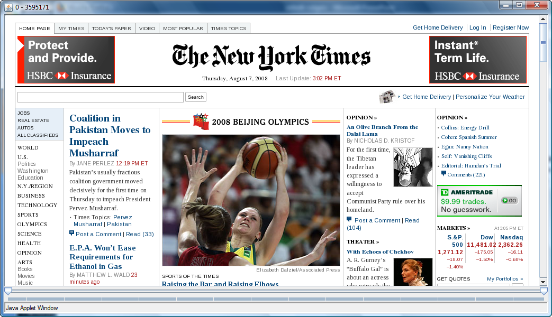
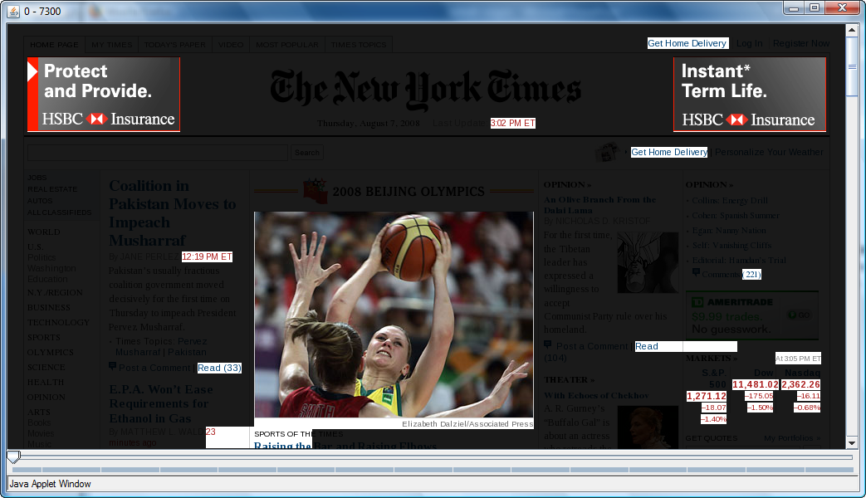
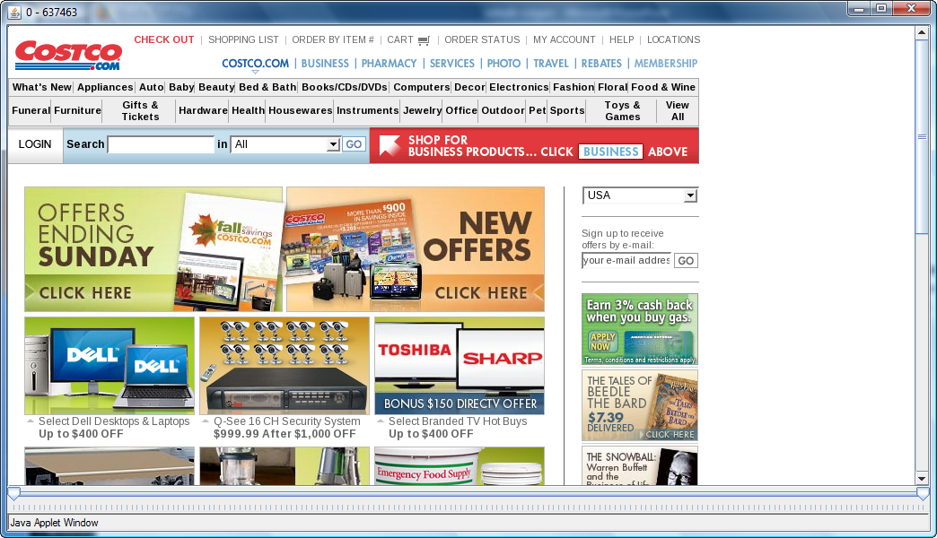
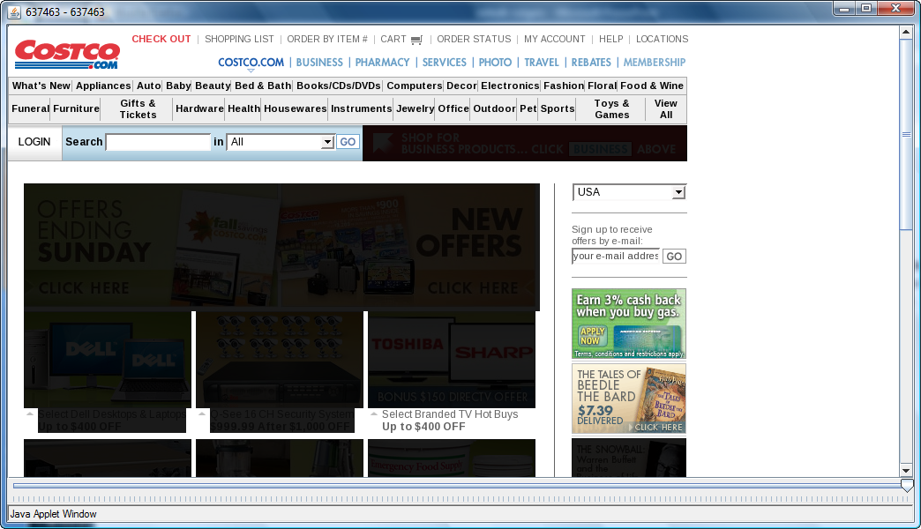
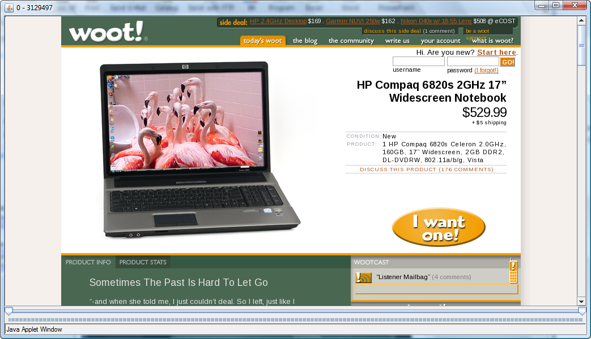
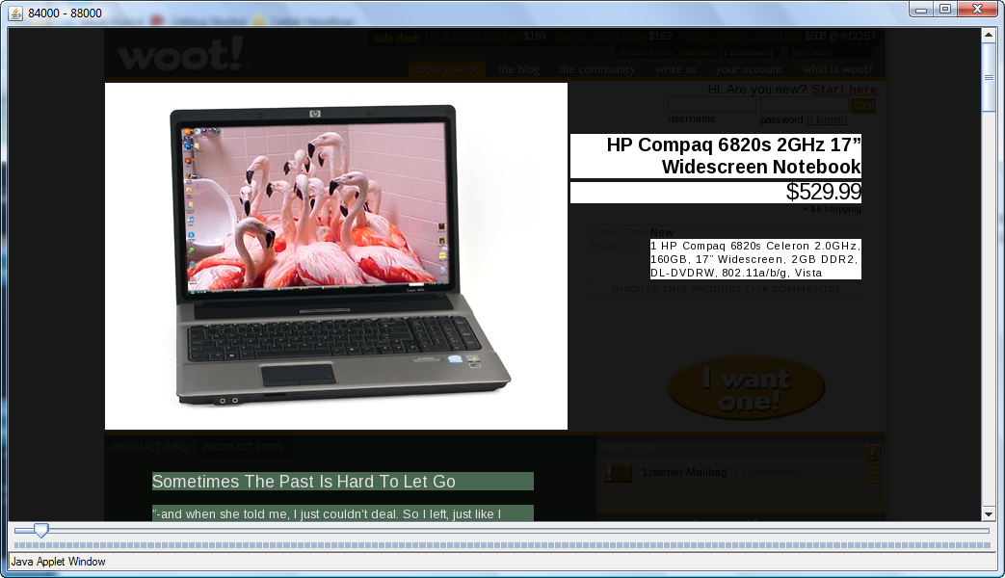
Unstable content monitoring
Stable content seeking
Change synchronization
[CHI09] Adar et al., “Resonance on the Web: Web Dynamics and Revisitation Patterns”
Notes:
Applying this idea to our sample pages we can see that the NY Times page now primarily displays highly dynamic information like stock prices and breaking news (and unfortunately some ads). For costco all the rapidly changing ads vanish and we’re left primarily with navigation information and search. And perhaps the nicest example is Woot where we block out all navigation information, fast changing ads and discussion and are left with just the main ad.

Slide 9
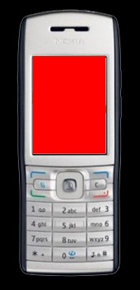
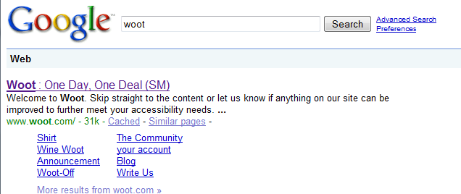
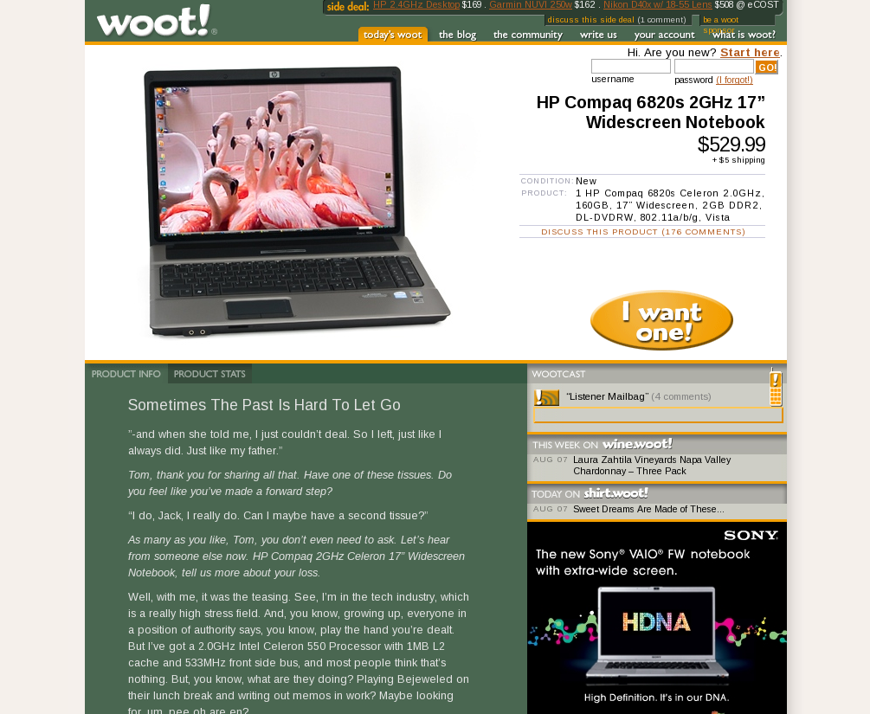
Applications
[CHI09] Adar et al., “Resonance on the Web: Web Dynamics and Revisitation Patterns”
Notes:
If we can do this, it would have applications to things like mobile browsers where instead of showing a very large page on a small screen, we can just pick the content of interest. Or in the case of a search engine where the snippet is generic, we might be able to provide one that is based on what users are actually going to care about.

Slide 10
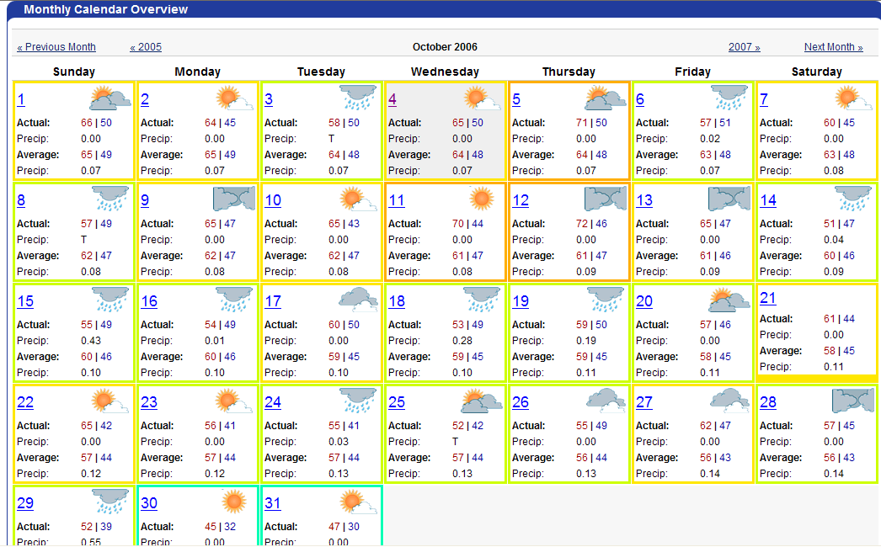
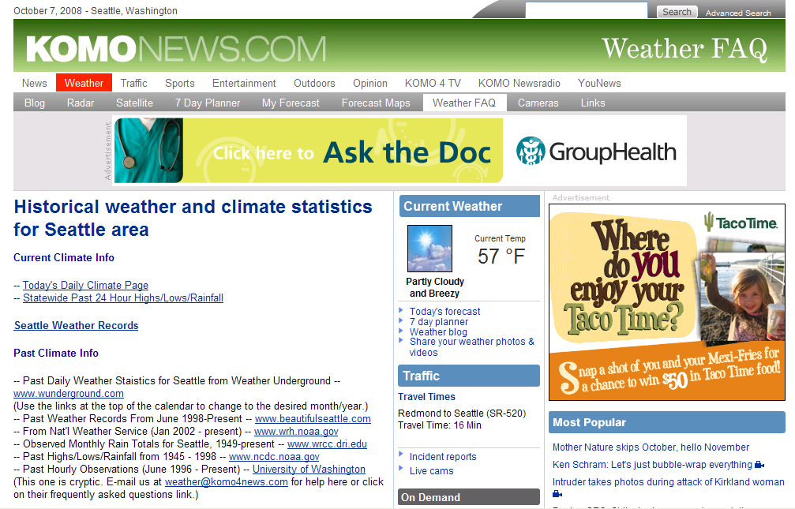
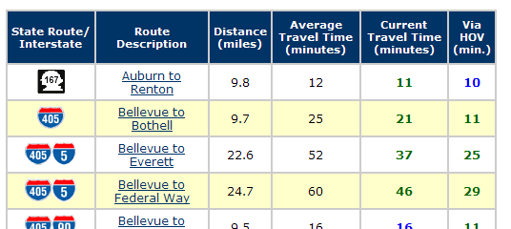
What is the relationship between
traffic and temperature in Seattle?
Manually collect, page by page
Now what?
Notes:
Lets work through an example to see what the problem is

Slide 11
traffic and temperature in Seattle?
an alternative…
Temp
t
Travel time
t
Notes:
Wouldn’t it be nicer to have a system that would have let us specify our information needs using the current data. So we could select the current temperate and find out historical data, select the current traffic conditions and get historical ones and then combine them?

Slide 12
Traffic and temperature in Seattle?
Temp
t
Travel time
t
Notes:
Wouldn’t it be nicer to have a system that would have let us specify our information needs using the current data. So we could select the current temperate and find out historical data, select the current traffic conditions and get historical ones and then combine them?

Slide 13
Demo
[UIST08] Adar et al., “Zoetrope: Interacting with the Ephemeral Web”
Notes:
Now it’s easier to show this before getting into the details so let me quickly pull up a demo.

Slide 14
Zoetrope Architecture
Zoetrope Front End
R₁
R₂
R₃
O₁
O₂
O₃
Zoetrope Engine
…
…
Data Store
XML/Images/Text/…
Web
Crawler
[UIST08] Adar et al., “Zoetrope: Interacting with the Ephemeral Web”
Notes:
The system is composed of X
Now let me just quickly cover some details of Zoetrope’s construction and what it offers

Slide 15
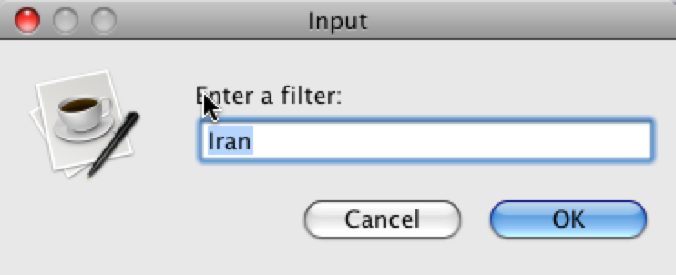
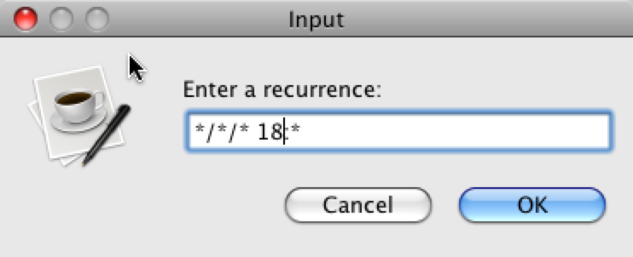
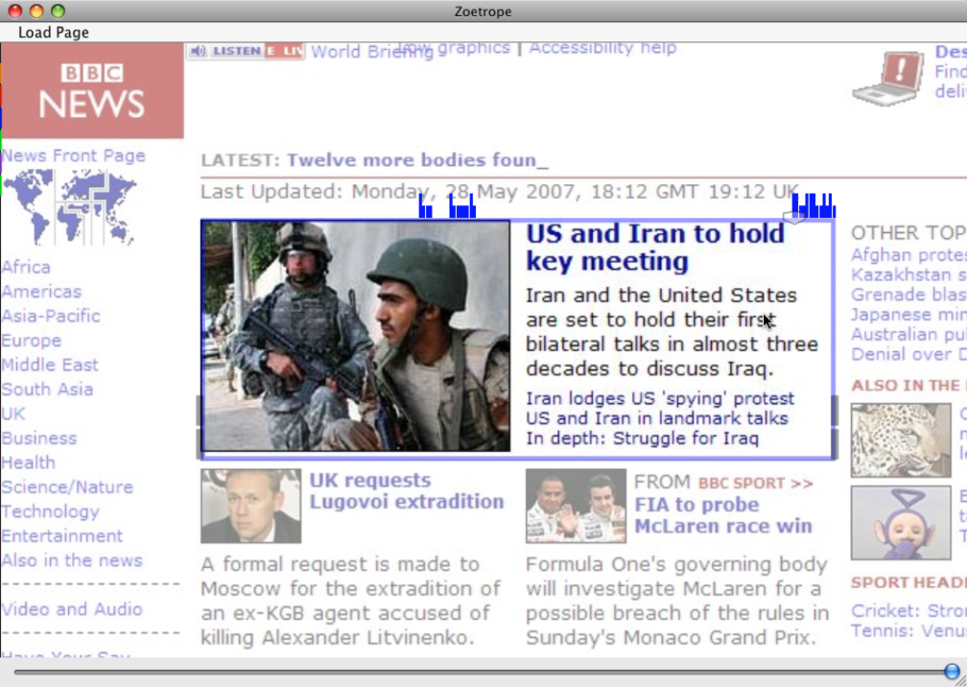
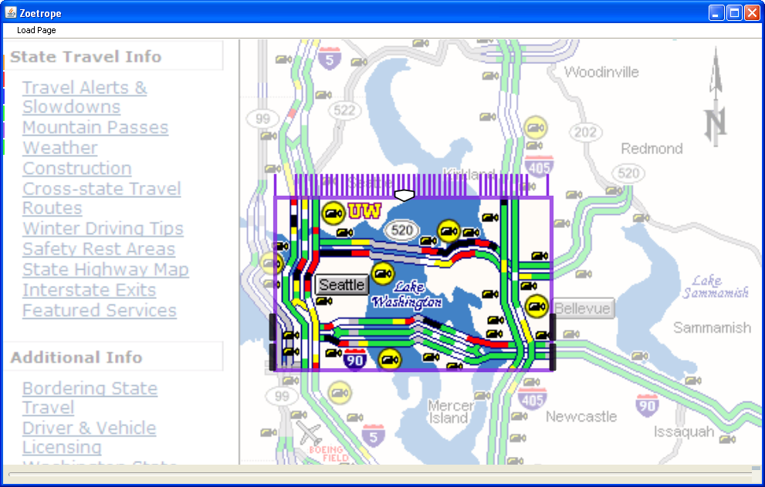
Filters
[UIST08] Adar et al., “Zoetrope: Interacting with the Ephemeral Web”
Notes:
A user may not always want to see every past instant of their selection so we provide a set of filters that define constraints on what gets extracted. For example, on the left the user specified the keyword Iran and we see little blue bars above the slider that indicate where Iran stories are and only lets the slider move to those locations. Users can also filter based on time, so if we only want to see bridge traffic at 6pm every day we can define a filter based on time.

Slide 16
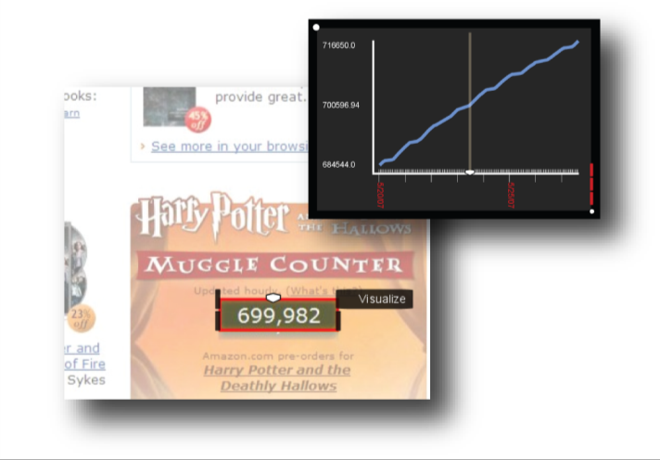
Visualizations (a few examples)
[UIST08] Adar et al., “Zoetrope: Interacting with the Ephemeral Web”
Notes:
Zoetrope offers three different lens types to select different kinds of information on the page. The first is a visual lens which assumes that what you want to extract is visually stable. So always at the same coordinate.

Slide 17
Ongoing work & Collaborations…

Slide 18
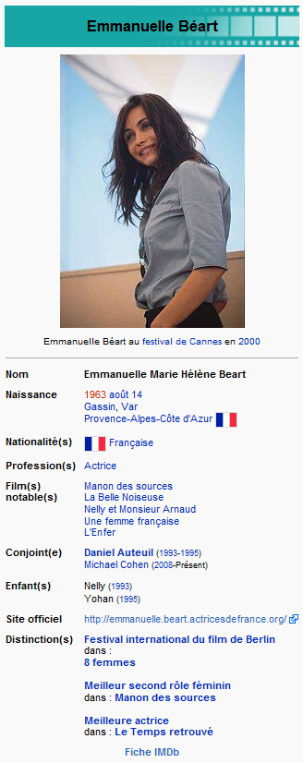
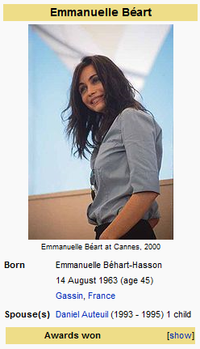
The idea
The problem
French
Many more details
2 children
New husband
time
visit
English
Notes:
The problem with the different rates of development can be seen in this example. We might have the french page for Emmanuelle Beart, a french actress which is updated fairly frequently, and the english page which is updated less frequently. If a user were to visit at this time. They would find factual differences between the two articles due to lags in updates. So for example, the french page correctly notes that she had remarried and now has 2 children.
Our idea is that one should be able to leverage the work in one language domain to update the other domains.

Slide 19
Future Work
Zoetrope
Learned extractions
Interactive interface lets users quickly validate lots of positive examples
Also tells us when extraction breaks
With a possible fix
Possible to learn the temporal extraction?

Slide 20
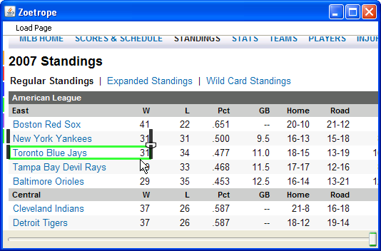
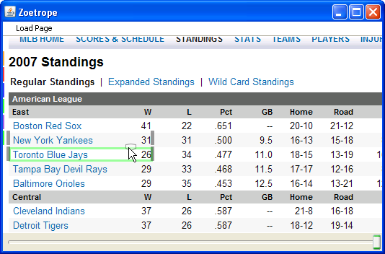
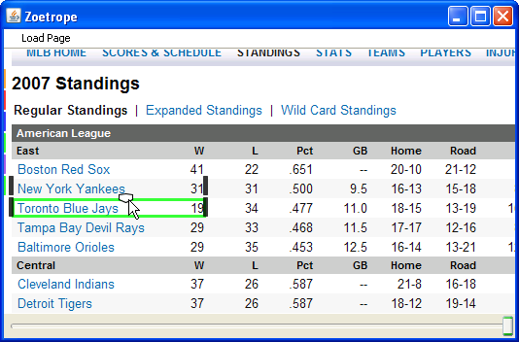
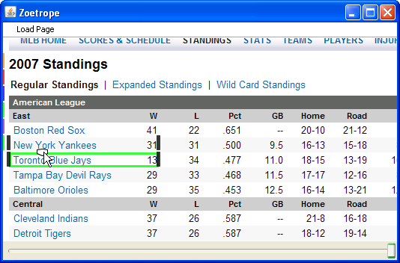
Query By Example
31
?
26
?
19
+(con)text
?
13
QBE System
(more) complete time series

Slide 21
Other stuff…
Tutorial extractions
With Adobe
Meez
Better search on structured data
Meme mutation
How does information evolve as it moves through networks

Slide 22
Information that is not present nor present...
Information that is not present nor present...
Information that is not present nor present...
Information that is past and absent...
Takeaway:
The Now Web is a limiting paradigm
Understanding the dynamics of content and behavior lets us improve existing applications and build ground breaking new ones
“
Present, adv. … at the present time, now; immediately, instantly, at once…
Present, adj. … existing in the thing, class, or case mentioned or under consideration…

Slide 23
Thanks!
?

