Slide 1
Text Retrieval and Data Mining in SI - An Introduction
Qiaozhu Mei
School of Information
Computer Science and Engineering
University of Michigan
qmei@umich.edu

Slide 2
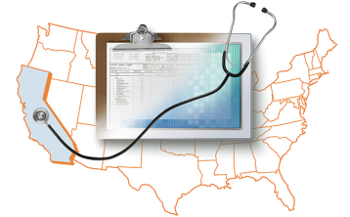
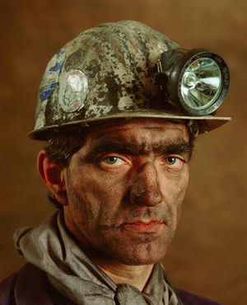
Challenge of Data Mining
Published Content: 3-4G/day
User generated data: 8-10G/day
Private text data: 3T/day
- Ramakrishnan and Tomkins 2007

Slide 3
What do We Do in this Battle?
Social Network Mining
Social networks
Query logs
Crowd
Online communities
Social bookmarks
Academic networks
Social Data Mining
Information networks
Social media
Health Informatics
tweets
Web Search
User
blogs
Content
authorship
sentiments
Context
impact
Scientific Literature
Information Retrieval
News articles
Contextual Text Mining
time
location
EHR
Statistical Topic Modeling
Web pages
event
Bioinformatics
Topics

Slide 4
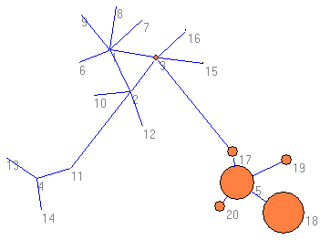
Personalization v.s. Diversification
MSR
→
Microsoft Research +
Microsoft Research Redmond +
Microsoft Research Asia …
Mountain Safety Research +
MSR Tents +
MSR Wheels +
Microsoft Research …
Mountain Safety Research +
Microsoft Research +
Metropolis Street Racer …
?
?
?
Personalized Rank
PageRank
Diverse Rank
- Joint work with Jian Guo, Qian Zhen

Slide 5
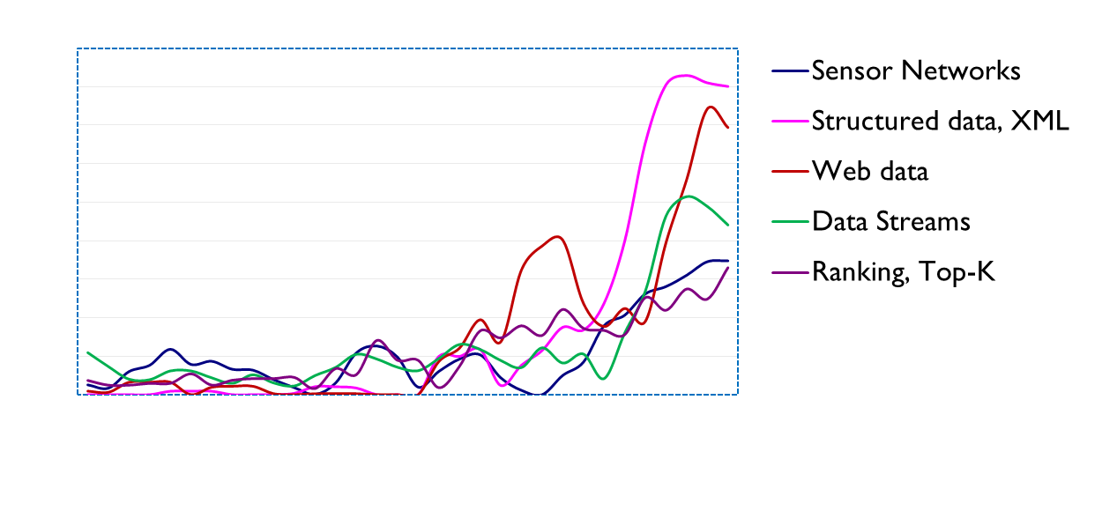
Topic Evolution and Trends
Hot Topics in SIGMOD
What’s hot in literature/twitter?
Notes:
Mention “context” more. Time as context

Slide 6
Modeling Spatiotemporal Topic Diffusion
One Week Later
How does discussion spread?
Topic =
“government response in hurricane Katrina”

Slide 7
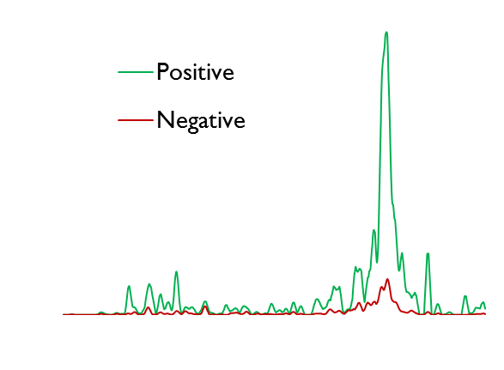
Summarizing and Tracking Opinions
The Da Vinci Code
Blogs; customer reviews
Tom Hanks, who is my favorite movie star act the leading role.
protesting... will lose your faith by watching the movie.
... so sick of people making such a big deal about a fiction book
a good book to past time.
What is good and what is bad?

Slide 8
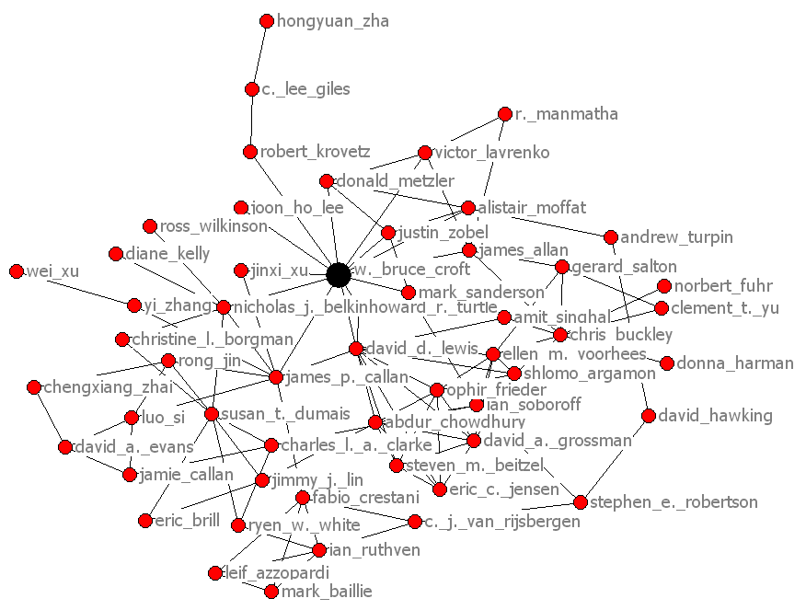
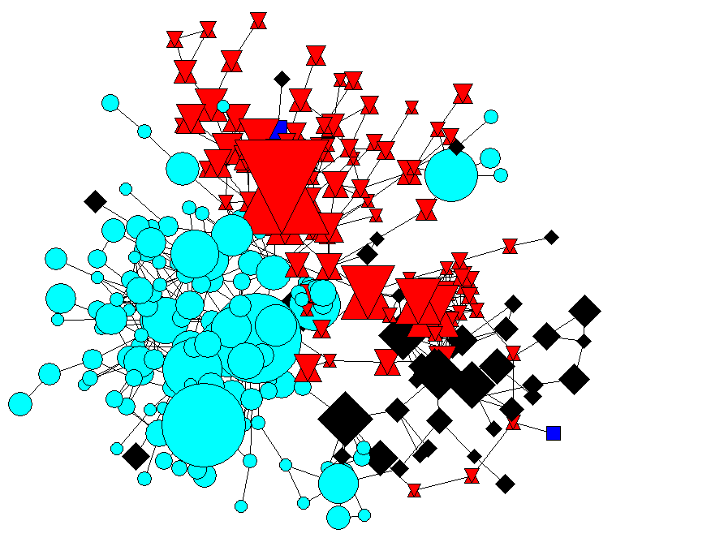
Topical Community Detection
Social/Academic Network
Information retrieval community
Machine learning
community
Data mining
community
Text Content
Who works together on what?

Slide 9
Thanks!
Joint work with Cheng Zhai, Ken Church, Bruce Schatz, Ravi Kumar, Andrew Tomkins, Denny Zhou, Jian Guo, Qian Zhen, Xu Ling, Duo Zhang, Deng Cai, Dong Xin, Chao Liu ...

