Slide 1
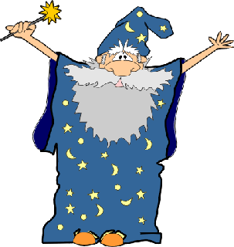
Privacy Wizards for Social Networking Sites
Lujun Fang, Kristen LeFevre
University of Michigan, Ann Arbor
Notes:
Hello, I’m Lujun Fang. I am very excited to present my work – privacy wizard for social networking sites. It is joint work with Professor Kristen LeFevre.

Slide 2
Privacy on Social Networking Sites
Social networking sites have grown rapidly in popularity
Facebook reports > 400 million active users
But privacy is still a huge problem
Users share a lot of personal information
Users have many “friends”
Not all information should be shared with every friend!
Notes:
(1) As you are probably aware, social networking sites like Facebok, MySpace, Orkut, etc. have grown rapidly over the past few years.
-- Facebook now reports over 400 million active users.
(2) But privacy is still a big problem
Users share lots of personal data (birthday, photos) with their friends
The average Facebook user has 130 friends (colleges, friends, or even people we barely known)
But the problem is that users have difficulty specifying which information should be shared with whom
(3) In the bigger picture, I think this is due to a new kind of environment, where average (non-technical) users, rather than trained system administrators, need to specify policies governing access to their own data.

Slide 3
Hey, I hate my job! My boss is %*#&Q!!
Hmm, you’re fired!
Notes:
(1) The ramifications of failing to configure these policies correctly can be severe
Here is a funny example that was making the rounds online last summer
(2) Basically, forgetting that her boss was her “friend,” this woman posted some harsh comments
(3) Seeing the status update, the boss then fired her

Slide 4
Goals and Challenges
Goal: Design a privacy “wizard” that automatically
configures a user’s privacy settings, with minimal
effort from the user.
Challenges
Low effort, high accuracy
Graceful Degradation
Visible Data
Incrementality
Notes:
We felt that there was a clear need for something better.
GOAL
In doing this, we encountered several challenges:
We could ask the user to hand-label all (friend, data item) pairs. This would produce perfect accuracy, but would require too much effort. We want to produce an accurate policy, with minimal effort from the user.
The wizard can request input from the user, but it is difficult to anticipate how much effort the user will be willing to expend. Thus, the wizard should adapt gracefully if the user abandons the process at any point.
In addition to the user’s input, the wizard can use other information that it can gather automatically. In the interest of confidentiality, however, and to eliminate the possibility of statistical disclosure, we made a decision to restrict this information to that which is already visible to the user. (Of course, in the future, we may be able to relax this restriction by using appropriate disclosure control mechanisms.)
Finally, as the user adds new friends, the policy should adapt gracefully, with little or no additional effort.

Slide 5
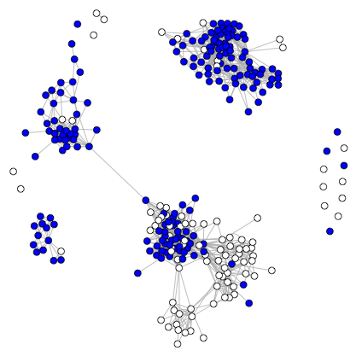
Privacy Wizard Framework
Basic Observation: Most users conceive their privacy preferences according to an implicit structure
Idea: With limited information, build a model to predict user’s preferences, auto-configure settings
KL’s neighborhood network; preference toward DOB
Notes:
I will start from a 10,000-foot view
At the most basic level, our wizard is based on the observation that users actually conceive their privacy preferences according to an implicit structure
As we will see, the network graph plays an important role in understanding this structure
For example, here is my neighborhood network (all of my friends, and their connections)
…

Slide 6
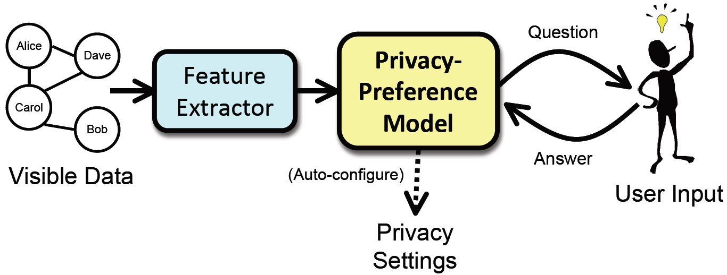
Generic Wizard Design
Notes:
Features extracted from a users’ ego network
Extraction user input by question and answer
Privacy preference model built though interaction with the user
Extract the privacy settings from the privacy preferences

Slide 7
Active Learning Wizard
Instantiation of the framework
View preference model as a classifier
View each friend as a feature vector
Predict class label (allow or deny)
Key Design Questions:
How to extract features from friends?
How to solicit user input?
Notes:
(1)As an instantiation of this framework, we built a sample wizard
(2) Basically, we view the preference model as a classifier, which predicts Ursula’s preference (allow or deny) toward each friend
(3) This leaves us with two main questions…

Slide 8
Extracting Features -- Example
Friends
 | Age | Sex | G₀ | G₁ | G₂ | G₂₀ | G₂₁ | G₂₂ | G₃ | Obama Fan | Pref. Label (DOB)
(Alice) | 25 | F | 0 | 1 | 0 | 0 | 0 | 0 | 0 | 1 | allow
(Bob) | 18 | M | 0 | 0 | 1 | 1 | 0 | 0 | 0 | 0 | deny
(Carol) | 30 | F | 1 | 0 | 0 | 0 | 0 | 0 | 0 | 0 | ?
…
G₀
G₁
{}
G₂
G₀ G₁ G₂ G₃
G₂₁
G₃
G₂₀
G₂₀ G₂₁ G₂₂
G₂₂

Slide 9
Soliciting User Input
Basic Principles
Ask simple questions
Ask informative questions
Approach: Ask user to label specific friends
E.g., “Would you like to share your Date of Birth with Alice Adams?”
Choose informative friends using an active learning approach
Uncertainty sampling
Notes:
(1)Our approach to soliciting user input is based on two principles…
(2)Studies have consistently shown that users have trouble reasoning holistically about access control policies. Thus, in our initial work, we started by asking users to assign labels to simple examples.
(3)Now, intuitively, it is important to ask the user to label the RIGHT examples… areas where it is not confident… we did this by applying the machine learning paradigm of active learning
And a long-standing active learning tool called uncertainty sampling

Slide 10
Evaluation
Questions: How effective is the active learning wizard, compared to alternative tools?
Methodology: Gathered raw preference data from 45 real Facebook users
Notes:
Now we have 50 more users

Slide 11
Experiments
Compared Effort/Accuracy tradeoff for three configuration tools
Brute-Force: Models current tools
DecisionTree:
Preference model is a decision tree
User labels randomly selected examples
DTree-Active:
Preference model is a decision tree
Examples chosen via uncertainty sampling
Notes:
Brute force is meant to mimic the process of assigning friends to lists
Specify the majority class (default), then label each user in the minority class (Explain this clearly!)

Slide 12
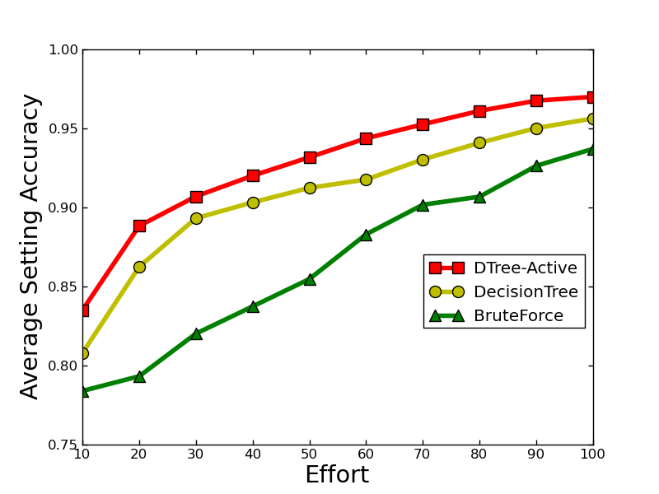
Results – Limited User Input
Notes:
Explain clear about this graph!

Slide 13
Effort / Accuracy Tradeoff
For static case, defined S_{static} score
Area under the effort/accuracy curve
Larger is better
Tool | S_{static}
 | mean | std
DTree-Active | 0.94 | 0.04
DTree | 0.92 | 0.05
BruteForce | 0.88 | 0.08

Slide 14
Conclusion
Social network users have trouble specifying detailed access control policies for their data
Proposed a “wizard” to ease the process
Solicit user input in the form of simple and informative examples (active learning)
Automatically-extracted communities as features
Improved effort/accuracy tradeoff over state of the art

Slide 15
Thank you!

