Slide 1

University of Michigan
Workshop on Data, Text, Web, and Social Network Mining
Friday, April 23, 2010
9:30 AM - 6 PM
Sponsored by Yahoo!, CSE, and SI
www.eecs.umich.edu/dm10

Slide 2
“U.S. households consumed approximately 3.6 zettabytes* of information in 2008”
Bohn and Short 2009
1 zettabyte = 1 thousand million million million bytes

Slide 3
Expectations
50 participants: 10 professors and 40 students
25 from CSE, 15 from SI, 5 from Statistics, 5 from other departments

Slide 4
Reality
> 34 EECS
> 22 SI
> 8 Statistics
> 8 Bioinformatics/MBNI/CCMB
> 5 Business school
> 2 Political Science
> 2 Mathematics
> 2 Pharmaceutical
> 2 ELI
> 2 Educational Studies
> 2 Astronomy
> 2 Complex Systems

Slide 5
> 1 Chemical Engineering
> 1 Epidemiology
> 1 Physics
> 1 Economics
> 1 Linguistics
> 1 Sociology
> 1 Kinesiology
> 1 Public Health
> 1 Nuclear Engineering
> 1 Mechanical Engineering
> 1 Mathematics
> 1 Financial Engineering
> 1 Applied Physics

Slide 6
> 4 Library
> 1 ISR
> 1 Museum of Anthro
> 1 Development Office
>
> 4 Ford
> 2 Gale
> 1 Visteon
>
> 2 Digital Media Common
> 2 Vector Research Ctr
> 1 UM-LSA
> 1 UM-HMRC/LSA
> 1 UM Engineering SCIP
> 1 UM
> 1 ULAM/Micro/CCMB
> 1 NOAO

Slide 7
A total of 140 people
Data
Data mining

Slide 8
Schedule
9:30 - 9:40 Introductory words
9:40 -11:00 Eight lab overviews
11:00-12:20 Six lab overviews + two tech pres.
12:20- 1:30 Lunch (catered)
1:30 - 2:40 Six tech presentations
2:45 - 3:30 Panel discussion “Critical Mass”
3:30 - 4:00 Fourteen posters
4:00 - 5:10 DLS, Raghu Ramakrishnan
5:10 - 6:00 Reception + posters

Slide 9
Introductory words
H. V. Jagadish
Farnam Jahanian, Chair of CSE
Raghu Ramakrishnan, Yahoo!

Slide 10
Lab Overviews
All Wordles – thanks to Jonathan Feinberg (wordle.net)

Slide 11
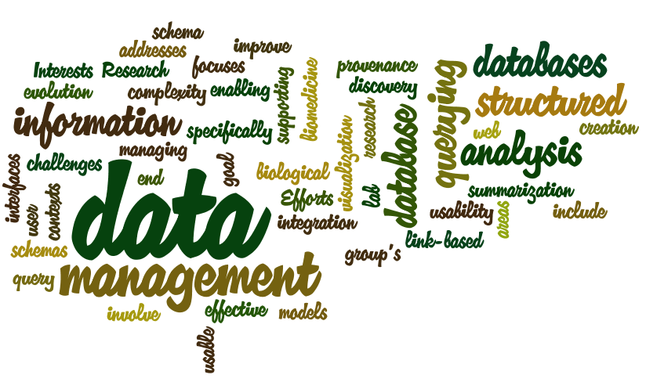
Dr. H.V. Jagadish

Slide 12
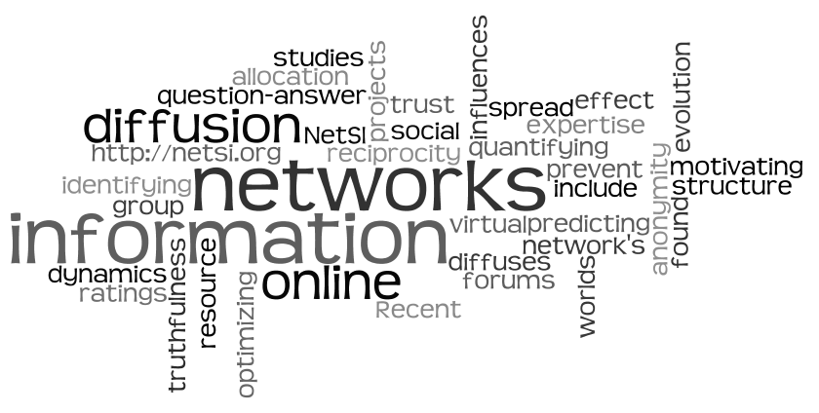
Dr. Lada Adamic

Slide 13
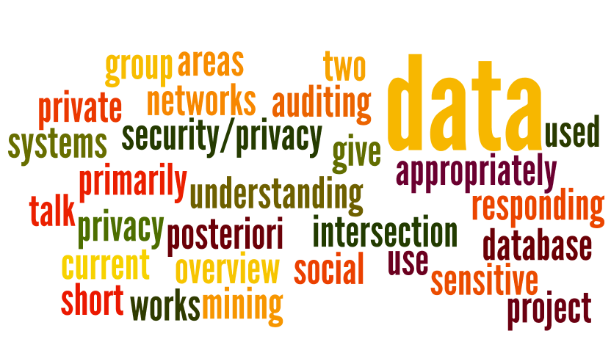
Dr. Kristen LeFevre

Slide 14
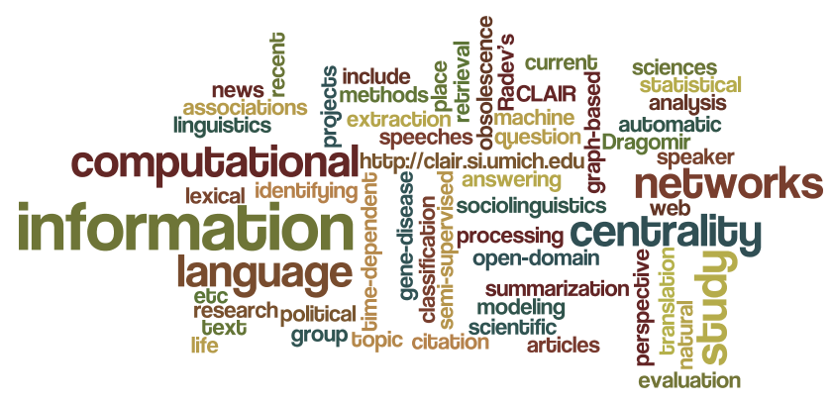
Dr. Dragomir Radev

Slide 15
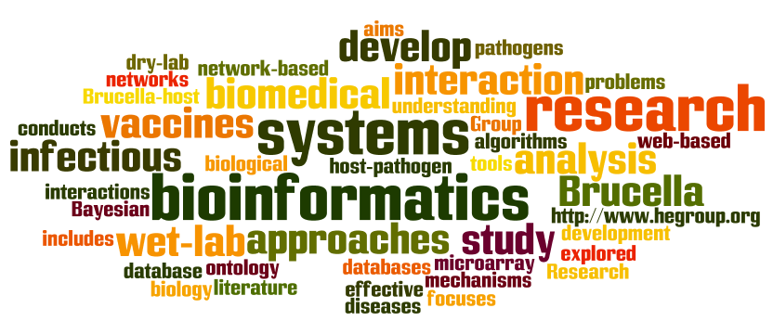
Dr. Yongqun “Oliver” He

Slide 16
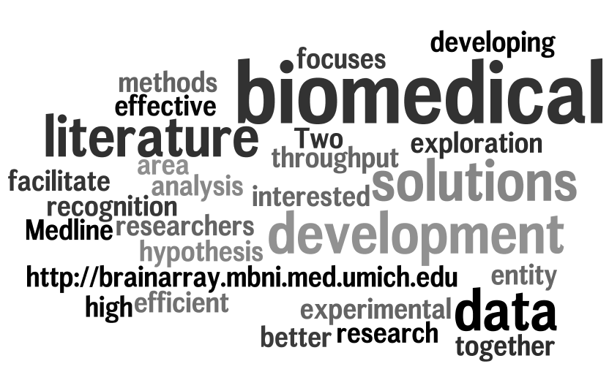
Dr. Fan Meng

Slide 17
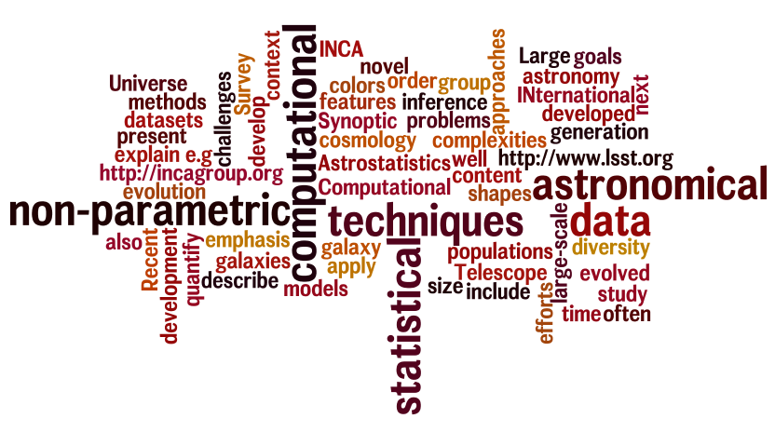
Dr. Chris Miller

Slide 18
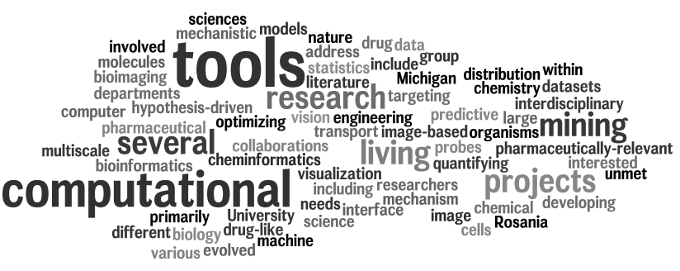
Dr. Gus Rosania

Slide 19
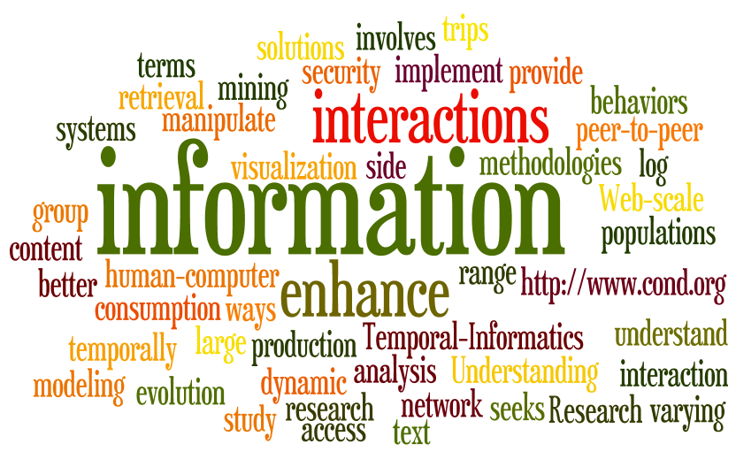
Dr. Eytan Adar

Slide 20
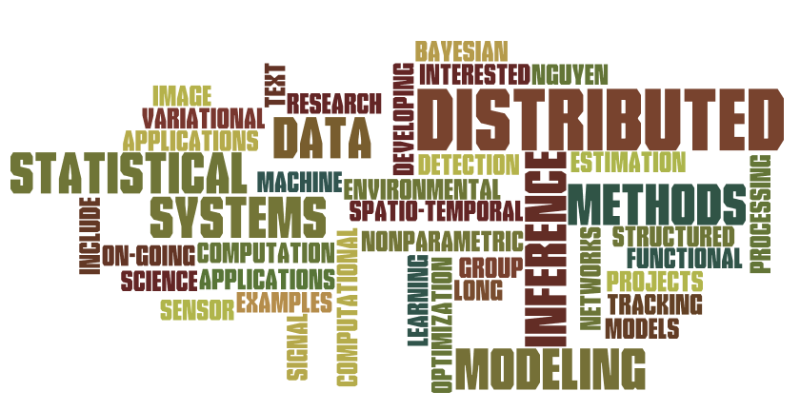
Dr. XuanLong Nguyen

Slide 21

Dr. Maggie Levenstein

Slide 22
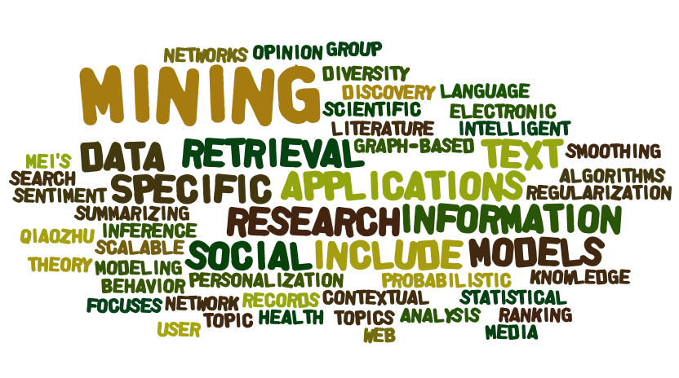
Dr. Qiaozhu Mei

Slide 23
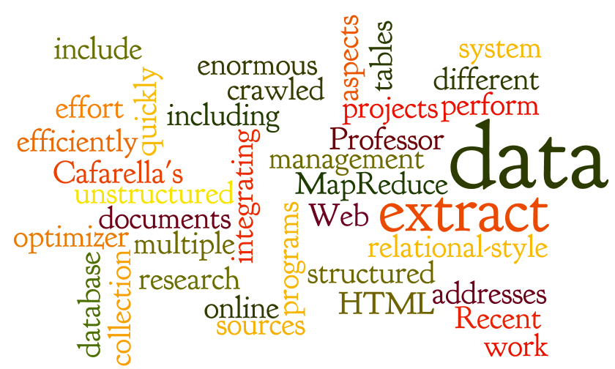
Dr. Michael Cafarella

Slide 24
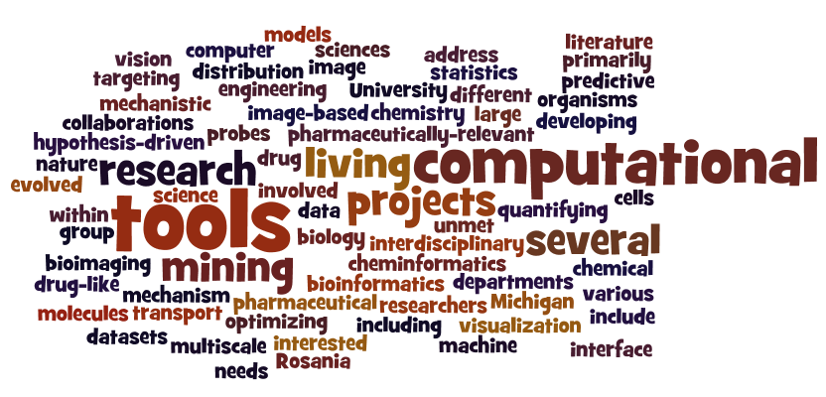
Dr. Gus Rosania

Slide 25
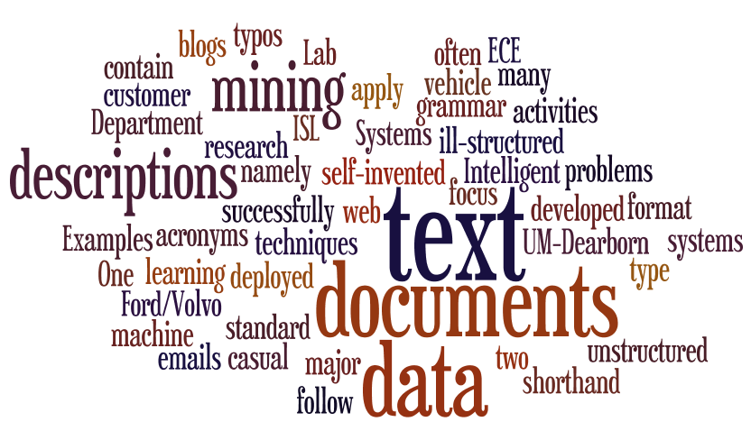
Dr. Yilu Murphey

Slide 26
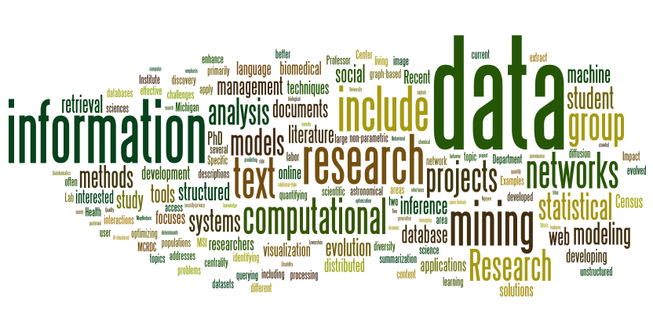
All Lab Overviews

Slide 27
DIAMETER?

Slide 28
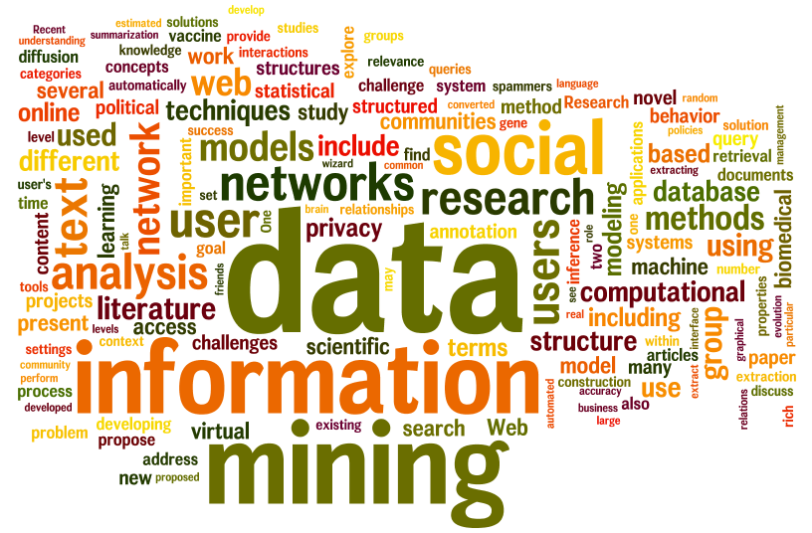
All Overviews, Presentations, and posters

Slide 29
Presentations

Slide 30
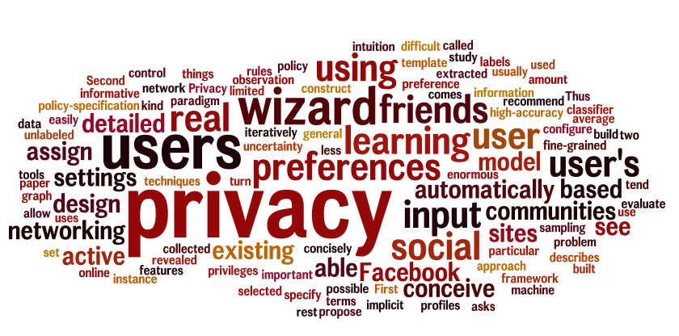
Lujun Fang, Kristen LeFevre, CSE
Privacy Wizards for Social Networking Sites

Slide 31
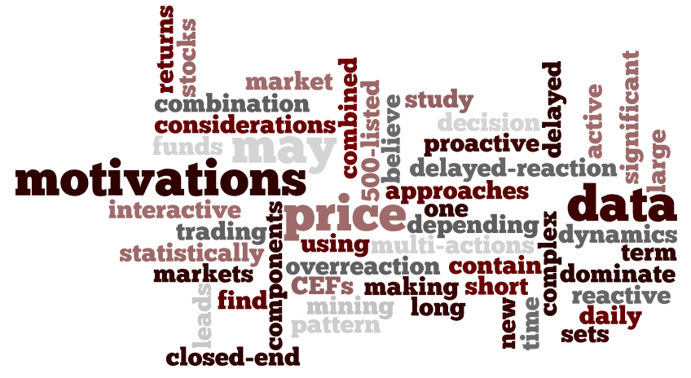
Ahmet Duran, Assistant Professor, Mathematics
Daily return discovery in financial markets

Slide 32
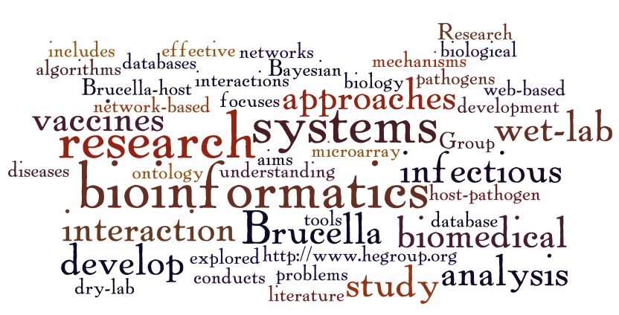
Yongqun “Oliver” He, Medical School
(Lab Overview)

Slide 33
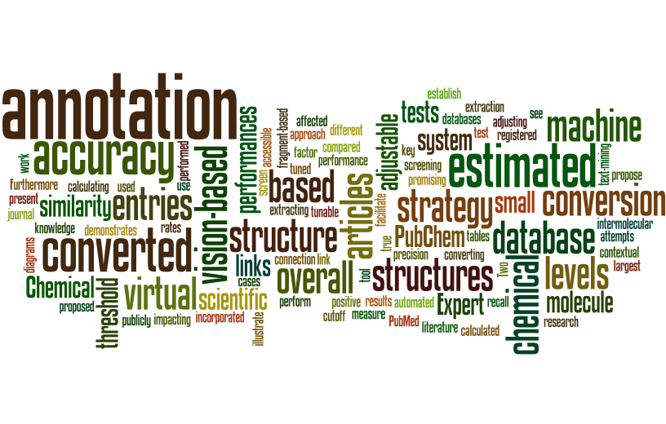
Jungkap Park, Mechanical Engineering, Gus R. Rosania, Pharmaceutical Sciences, and Kazuhiro Saitou, Mechanical Engineering
Tunable Machine Vision-Based Strategy for Automated Annotation of Chemical Databases

Slide 34
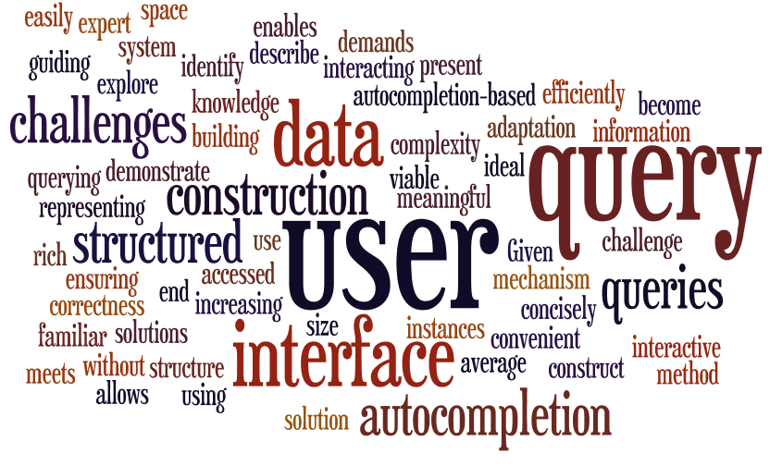
Arnab Nandi, H.V. Jagadish, CSE
Autocompletion for Structured Querying

Slide 35
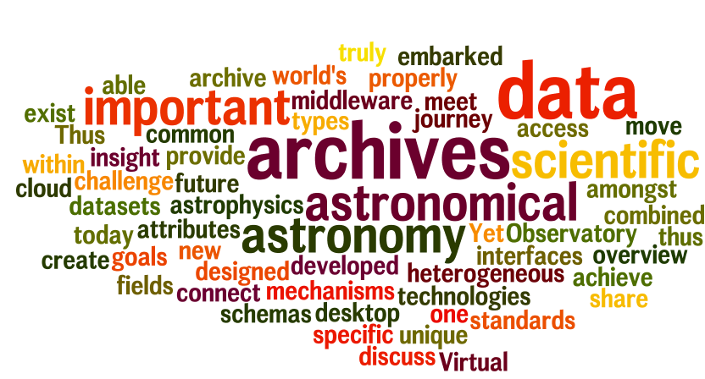
Christopher J. Miller, Astronomy
Astronomy in the Cloud: The Virtual Observatory

Slide 36
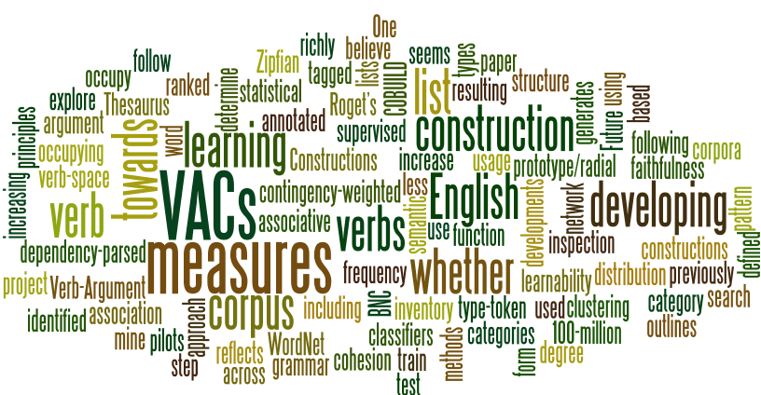
Matthew Brook O’Donnell and Nick C. Ellis, Linguistics
Extracting an Inventory of English Verb Constructions from Language Corpora

Slide 37
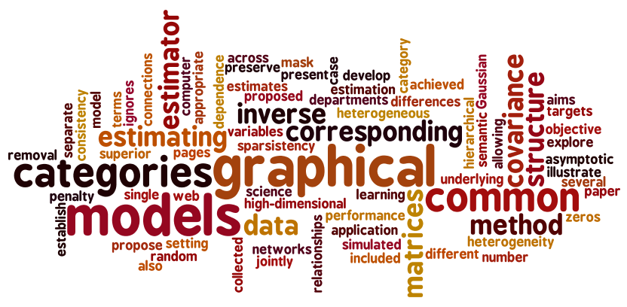
Jian Guo, Elizaveta Levina, George Michailidis, and Ji Zhu, Statistics
Joint Estimation of Multiple Graphical Models

Slide 38
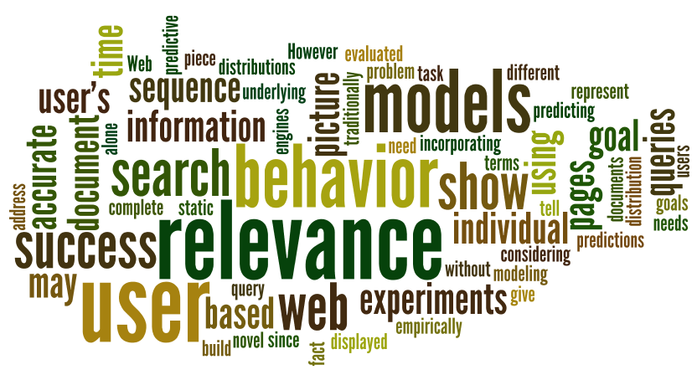
Ahmed Hassan, CSE, Rosie Jones, Yahoo! Labs, and Kristina Klinkner, Carnegie-Mellon University
Beyond DCG: User Behavior as a Predictor of a Successful Search

Slide 39
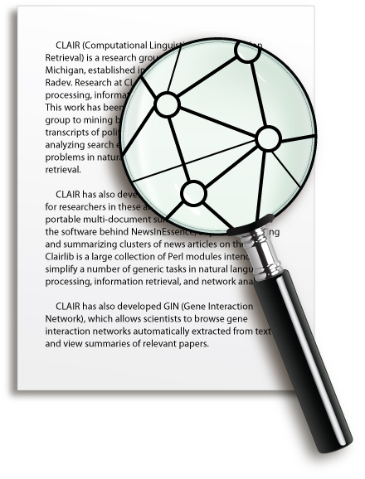
Students:
Arzucan Ozgur
Ahmed Hassan
Adam Emerson
Vahed Qazvinian
Amjad abu Jbara
Pradeep Muthukrishnan
Yang Liu
Prem Ganeshkumar
CLAIR

Slide 40
Statistical and network-based approaches to natural language processing and information retrieval

Slide 41
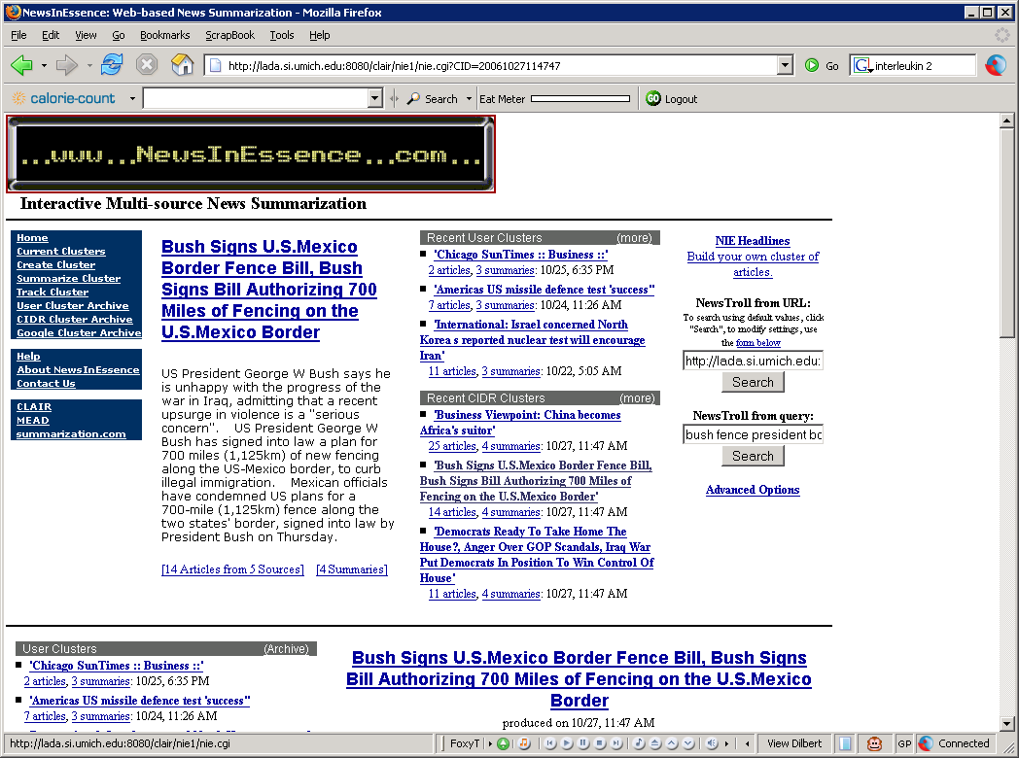
[NSF CST grant]

Slide 42
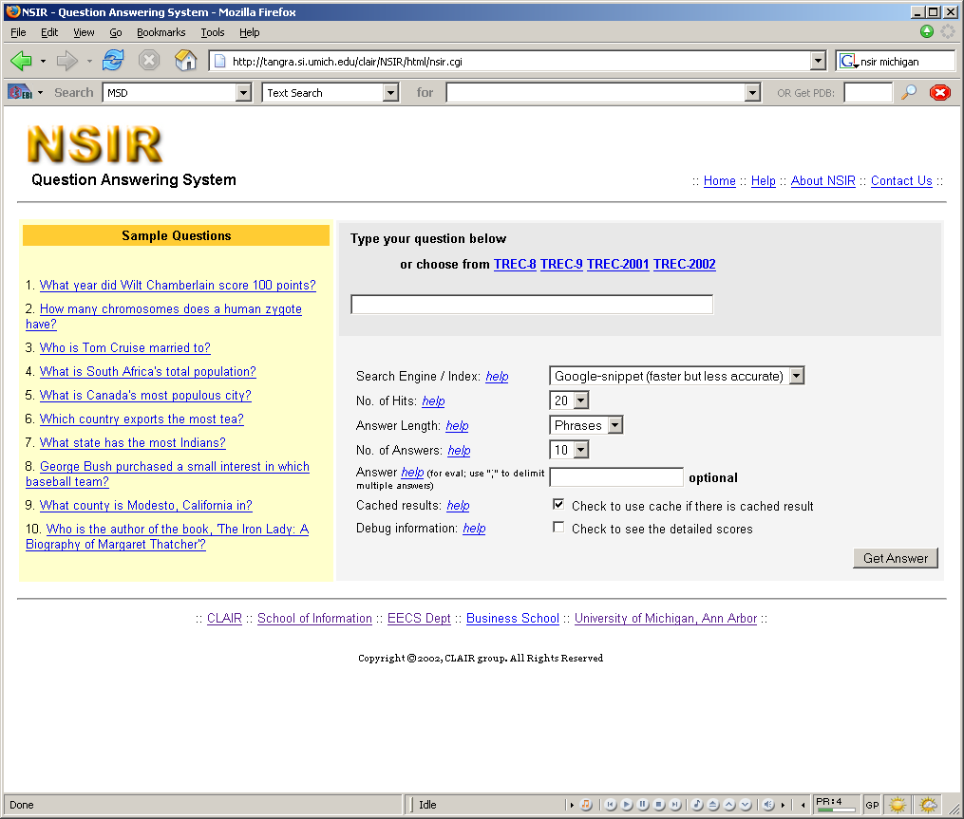

Slide 43
Sample projects
Summarization
  Single and multiple sources, multiple perspectives, evolving text
Question answering
  Open-domain, natural language
Information extraction
  Events, speculation, interactions, networks
Semi-supervised text classification
  TUMBL
Lexical centrality
  Lexrank, speakers, topics
Survey generation
  AAN, iOpener
Computational sociolinguistics
  Polarity, cliques and rifts

Slide 44
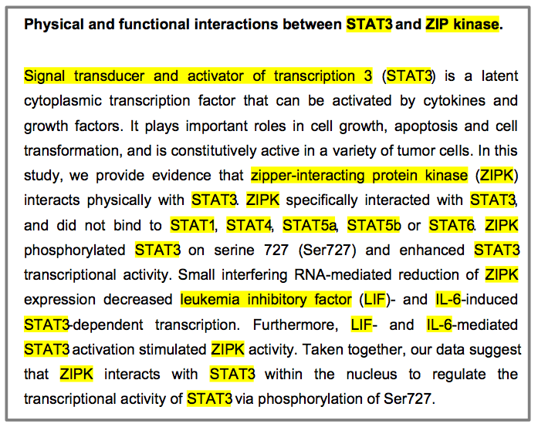
Relationships (interactions)
Negation
Site
Type
Complex events
Directionality (Causality)
Speculation
Experiment Type
full text of paper
cellular location
Species

Slide 45
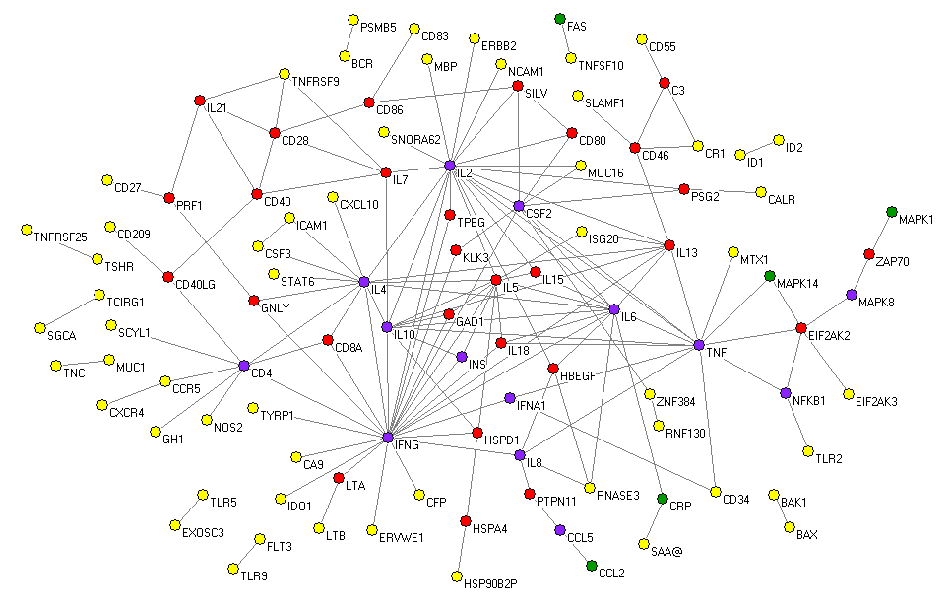
IFNG-vaccine network
Important genes:
- degree
- eigenvector
- closeness
- betweenness
central in both
central in vaccine
central in generic
Joint work with Oliver He, Med. School

Slide 46
Speaker 1
Speeches
Speech Scores
1 0.13
2 0.13
3 0.10
4 0.19
5 0.10
6 0.14
7 0.08
8 0.13
Speaker Scores (mean speech score)
1 0.12
2 0.15
3 0.12
3
2
4
Speaker 2
Speeches
1
5
6
8
7
Speaker 3
Speeches

Slide 47
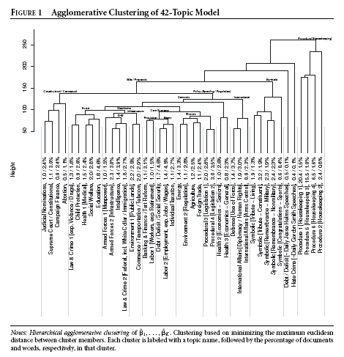

Slide 48
Temporal Evolution of Speaker Salience
Parliamentary discussions represent a very important source of debates
Certain persons act as experts or influential people
How can we detect influential speakers?
How can we track their salience over time?
.

Slide 49
Temporal Evolution of Speaker Salience
Build a content based network of speakers that evolves over time
Edge weight becomes a function of time:
Impact of similarity decreases as time increases in an exponential fashion.
2005
2006
2008
2007
2009
Joint work with Burt Monroe, Penn State and Kevin Quinn, Harvard

Slide 50
1. A police official said it was a Piper tourist plane and that the crash had set the top floors on fire.
2. According to ABCNEWS aviation expert John Nance, Piper planes have no history of mechanical troubles or other problems that would lead a pilot to lose control.
3. April 18, 2002 8212; A small Piper aircraft crashes into the 417-foot-tall Pirelli skyscraper in Milan, setting the top floors of the 32-story building on fire.
4. Authorities said the pilot of a small Piper plane called in a problem with the landing gear to the Milan's Linate airport at 5:54 p.m., the smaller airport that has a landing strip for private planes.
5. Initial reports described the plane as a Piper, but did not note the specific model.
6. Italian rescue officials reported that at least two people were killed after the Piper aircraft struck the 32-story Pirelli building, which is in the heart of the city s financial district.
7. MILAN, Italy AP A small piper plane with only the pilot on board crashed Thursday into a 30-story landmark skyscraper, killing at least two people and injuring at least 30.
8. Police officer Celerissimo De Simone said the pilot of the Piper Air Commander plane had sent out a distress call at 5:50 p.m. just before the crash near Milan's main train station.
9. Police officer Celerissimo De Simone said the pilot of the Piper aircraft had sent out a distress call at 5:50 p.m. 11:50 a.m.
10. Police officer Celerissimo De Simone said the pilot of the Piper aircraft had sent out a distress call at 5:50 p.m. just before the crash near Milan's main train station.
11. Police officer Celerissimo De Simone said the pilot of the Piper aircraft sent out a distress call at 5:50 p.m. just before the crash near Milan's main train station.
12. Police officer Celerissimo De Simone told The AP the pilot of the Piper aircraft had sent out a distress call at 5:50 p.m. just before crashing.
13. Police say the aircraft was a Piper tourism plane with only the pilot on board.
14. Police say the plane was an Air Commando 8212; a small plane similar to a Piper.
15. Rescue officials said that at least three people were killed, including the pilot, while dozens were injured after the Piper aircraft struck the Pirelli high-rise in the heart of the city s financial district.
16. The crash by the Piper tourist plane into the 26th floor occurred at 5:50 p.m. 1450 GMT on Thursday, said journalist Desideria Cavina.
17. The pilot of the Piper aircraft, en route from Switzerland, sent out a distress call at 5:54 p.m. just before the crash, said police officer Celerissimo De Simone.
18. There were conflicting reports as to whether it was a terrorist attack or an accident after the pilot of the Piper tourist plane reported that he had lost control.
1. Police officer Celerissimo De Simone said the pilot of the Piper aircraft, en route from Switzerland, sent
out a distress call at 5:54 p.m. just before the crash near Milan's main train station.
2. Italian rescue officials reported that at least three people were killed, including the pilot, while
dozens were injured after the Piper aircraft struck the 32-story Pirelli building, which is in the heart
of the city s financial district.

Slide 51
0.01718 Red Sox Win Baseball's World Series Title by Sweeping Rockies
0.01712 Red Sox Sweep Rockies To Win World Series
0.01647 World Series: Red Sox sweep Rockies
0.01630 Red Sox sweep Rockies, take World Series
0.01608 Red Sox 4, Rockies 3 Boston Sweeps World Series Again
0.01597 World Series: Red Sox complete sweep of Rockies
0.01584 Red Sox sweep World Series
0.01579 Red Sox Sweep Colorado in World Series
0.01573 Red Sox Complete Sweep Of Rockies For World Series Victory
0.01531 Red Sox complete World Series sweep
...
0.01057 Boston Red Sox blank Rockies to clinch World Series
0.01052 Red Sox: Dynasty in the making
0.01037 Sox sweep Rockies for 2nd title in 4 seasons
0.01034 Police Arrest Dozens After Red Sox World Series Win
0.01027 Rookies respond in first crack at the big time
0.01018 Rockies: Sweep, sweep, swept
0.01016 Sweeping off to Boston
0.01013 Rookies rise to occasion!
0.01012 Fans celebrate Red Sox win
0.01010 Short wait for bosox this time
...
0.00441 Sox are kings of diamond
0.00414 Rockies just failed to execute
0.00408 Rockies Find Being Good Isnt Enough
0.00407 Rockies' heads held high despite loss
0.00391 Boston lowers the broom
0.00390 Rockies Vanish In Thin Air
0.00390 Poor pitching, poorer hitting doom Rockies
0.00390 Rockies feel the pain, but not the shame
0.00375 Two titles four years apart impossible to compare
0.00362 Boston reigns supreme

Slide 52
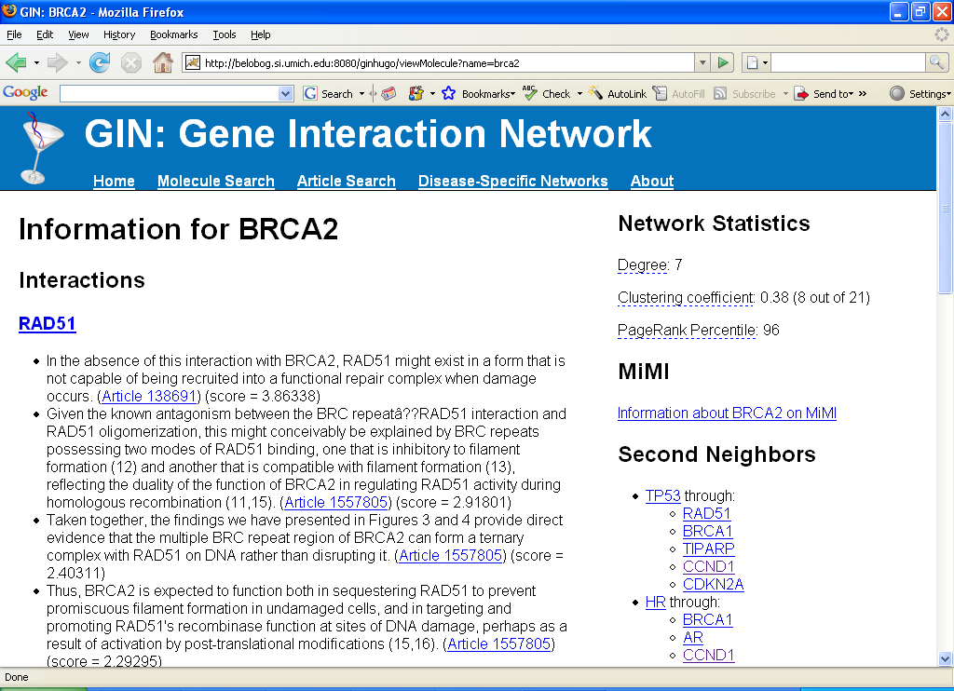

Slide 53
C08-1051 1 7:191 Furthermore, recent studies revealed that word clustering is useful for semi-supervised learning in NLP (Miller et al., 2004; Li and McCallum, 2005; Kazama and Torisawa, 2008; Koo et al., 2008).
D08-1042 2 78:214 There has been a lot of progress in learning dependency tree parsers (McDonald et al., 2005; Koo et al., 2008; Wang et al., 2008).
W08-2102 3 194:209 The method shows improvements over the method described in (Koo et al., 2008), which is a state-of-the-art second-order dependency parser similar to that of (McDonald and Pereira, 2006), suggesting that the incorporation of constituent structure can improve dependency accuracy.
W08-2102 4 32:209 The model also recovers dependencies with significantly higher accuracy than state-of-the-art dependency parsers such as (Koo et al., 2008; McDonald and Pereira, 2006).
W08-2102 5 163:209 KCC08 unlabeled is from (Koo et al., 2008), a model that has previously been shown to have higher accuracy than (McDonald and Pereira, 2006).
W08-2102 6 164:209 KCC08 labeled is the labeled dependency parser from (Koo et al., 2008); here we only evaluate the unlabeled accuracy.

Slide 54
Longer-term interests
Collective discourse
Data obsolescence
Collective intelligence
Survey generation
Lexical networks
Complex systems approach to language
Emergence of diversity
Physics of NLP
Properties of surrogates
NLP as OS

Slide 55
Demos and software
Clairlib
AAN
Book: Graph-based methods for NLP/IR
NACLO

